Slide 1
PGC Worldwide Lab Call Details
DATE: Friday, February 22nd, 2013
PRESENTER: Naomi Wray, The University of Queensland, Australia
TITLE: “Genetic relationship between five psychiatric disorders estimated from genome-wide SNPs”
START: We will begin promptly on the hour.
1100 EST - US East Coast
0800 PST - US West Coast
1600 GMT - UK
1700 CET - Central Europe
0300 EDT – Australia (Saturday, February 23rd, 2013)
DURATION: 1 hour
TELEPHONE:
- US Toll free: 1 866 515.2912
- International direct: +1 617 399.5126
- Toll-free number? See http://www.btconferencing.com/globalaccess/?bid=75_public
- Operators will be on standby to assist with technical issues. “*0” will get you assistance.
- This conference line can handle up to 300 participants.
PASSCODE: 275 694 38

Slide 2
Lines are Muted NOW
Lines have been automatically muted by operators as it is possible for just one person to ruin the call for everyone due to background noise, electronic feedback, crying children, wind, typing, etc.
Operators announce calls one at a time during question and answer sessions.
Dial *1 if you would like to ask a question of the presenter. Presenter will respond to calls as time allows.
Dial *0 if you need operator assistance at any time during the duration of the call.

Slide 3
UPCOMING
PGC Worldwide Lab Call Details
DATE: Friday, March 15th, 2013
PRESENTER: Shaun Purcell, Mt Sinai School of Medicine, NYC
TITLE: To Be Announced / “Exome Sequencing in Psychiatric Disorders”
START: We will begin promptly on the hour.
1000 EST - US East Coast
0700 PST - US West Coast
1400 GMT - UK
1500 CET - Central Europe
0100 EDT – Australia (Saturday, March 16th, 2013)
DURATION: 1 hour
TELEPHONE:
- US Toll free: 1 866 515.2912
- International direct: +1 617 399.5126
- Toll-free number? See http://www.btconferencing.com/globalaccess/?bid=75_public
- Operators will be on standby to assist with technical issues. “*0” will get you assistance.
- This conference line can handle up to 300 participants.
PASSCODE: 275 694 38

Slide 4

Genetic relationship between five psychiatric disorders estimated from genome-wide SNPs
Naomi R Wray
Please note: in putting together this slide set I provide slides that I will talk to but include slides that are simply there for reference – hence small type

Slide 5
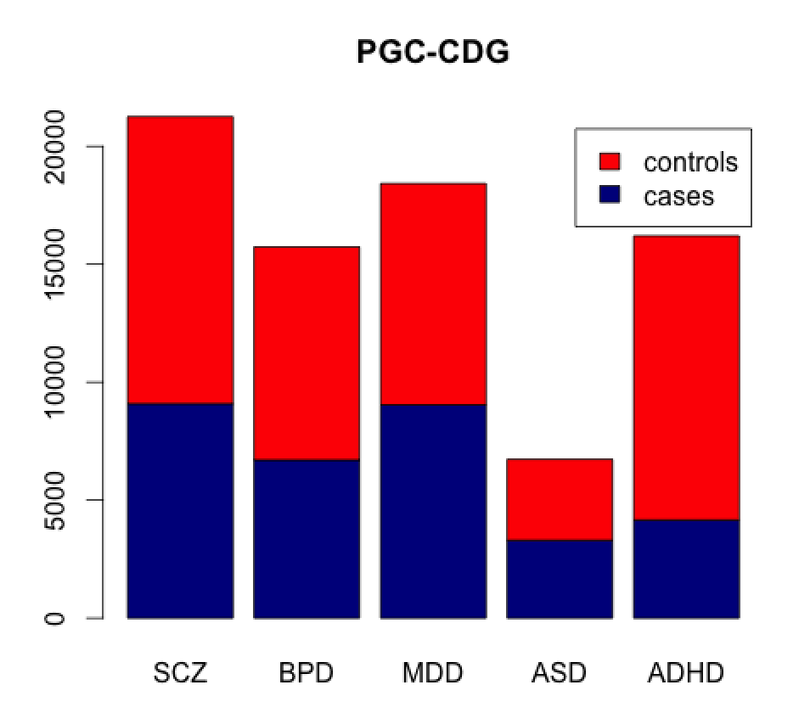

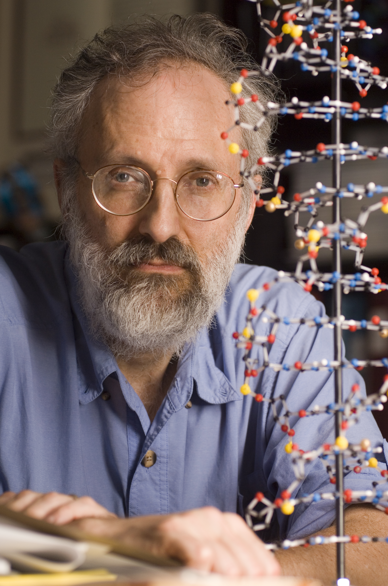
  Psychiatric Genomics Consortium
  Cross-disorder Group
  PGC-CDG: 320 scientists from 19 countries
S. Hong Lee Ken Kendler
  Stephan Ripke
  Ben Neale
  Shaun Purcell
  Steve Faraone
  Jordan Smoller
  Roy Perlis
  Bryan Mowry
  Pat Sullivan
PGC Wave 1, except for ADHD

Slide 6
Summary of genetics of psychiatric disorders: PGC wave 1
a. Some are pseudo-controls
Getting your head around quantitative genetics of disease
Prevalence 1%
Heritability of liability 80%
Risk to first-degree relatives 8%
Risk to MZ twin 50%
Proportion of those affected with no 1st - degree relative affected: > 75 %
Proportion of those affected with no 1st, 2nd or 3rd –degree relative affected: > 60 %
Complex genetic diseases appear to be sporadic

Slide 7
Summary of PGC-CDG association analyses
In press Lancet
4 loci genome-wide significant association
3p21
10q24
two L-type voltage-gated calcium channel subunits, CACNA1C and CACNB2.
Model selection analysis supported effects of these loci across multiple disorders.

Slide 8
PGC-CDG profile scoring analyses
ADHD is PGC Wave 1 only
Profile scoring method
Wray, Goddard, Visscher 2007 Genome Research
Purcell et al, 2009 International Schizophrenia Consortium
Not optimal use of data
P-value thresholds arbitrary
Pruning based on LD arbitrary
Depends on sample size in training sample

Slide 9
Two key questions to progress our understanding of psychiatric disorders
What evidence can we provide that psychiatric disorders are like most other common complex disorders and that common variation contributes to the spectrum of genetic architecture?
What evidence can we provide that there is a common genetic susceptibility to psychiatric disorders?
Missing heritability
Heritability from family studies has been overestimated yes but not that much
  From single hospital/environment
  Confounding with other factors including non-additive genetic
Rare genetic variants so not tagged by SNPs of course, but all?
Common variants that are too small to show as significant hiding heritability
Fundamental misunderstanding always keep an open mind

Slide 10
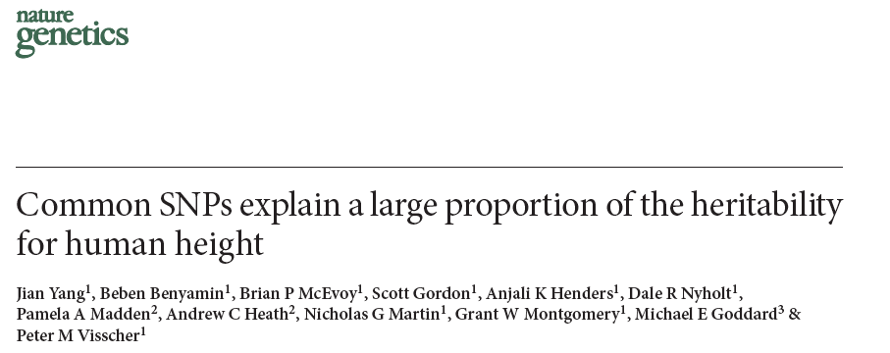



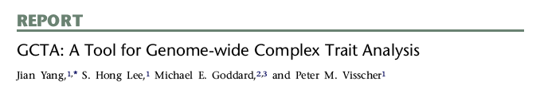
Whole genome multi-SNP methods: SNP-heritability
Take individuals “unrelated” in the classical sense
Estimate genetic relationships between all pairs of individuals
Relationships very small, but precision comes from large number of relationships
SNP heritability > 0 when individuals that are genetically more similar are phenotypically more similar
When applied to sample N =11,576
10% of variance explained by genome-wide significant
SNP heritability= 42% (SE 3%)
Shows us what can be found
V 1.11 much faster

Slide 11
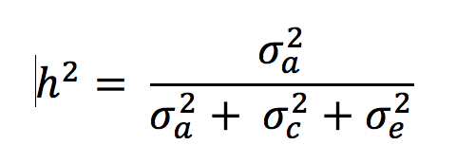
Estimation of heritability from twin study
(forget about genotypes for the moment)
ACE model y = μ + a + c + e
y - phenotype
a – genetic values of individuals – correlated between individuals
c – common/shared family environment effects – independent across families
e - individual environmental/error effects – independent across individuals
1 | 1 | 0 | 0 | 0 | 0 | 0 | 0
1 | 1 | 0 |  | 0 | 0 | 0 | 0
0 | 0 | 1 | 0.5 | 0 | 0 | 0 | 0
0 | 0 | 0.5 | 1 | 0 | 0 | 0 | 0
0 | 0 | 0 | 0 | 1 | 0.5 | 0 | 0
0 | 0 | 0 | 0 | 0.5 | 1 | 0 | 0
0 | 0 | 0 | 0 | 0 | 0 | 1 | 1
0 | 0 | 0 | 0 | 0 | 0 | 1 | 1
Limitations:
Sample size
Limited types of family relationship
Often difficult to separate a and c
Possible confounding with non-additive effects
A =

Slide 12
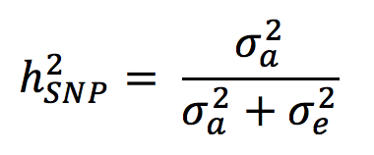
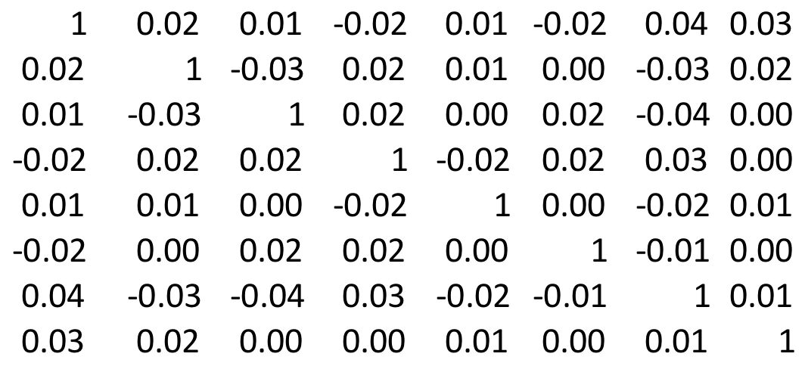
Whole genome multi-SNP methods
AE model y = μ + a + e
No need for c because take such distant relatives < 2nd cousins – unlikely to have shared common environment (except socio-economic status?)
Confounding with non-additive genetic effects unlikely because additive relationships are so small (additive relationship = u, non-additive = u²)
a lower bound for narrow-sense (additive) heritability
Although additive relationships (similarities) being very small sample sizes are very large
Total sample size 10,000
Total number of pairs of relationships 50 million
A =

Slide 13
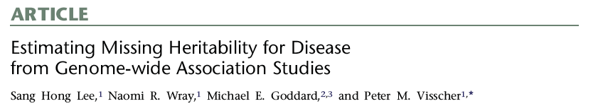
Extension to case-control studies
Take ‘unrelated’ individuals
Estimate genetic relationships between all pairs of individuals from genotyped markers
Estimate of variance > zero when
case-case pairs and control-control pairs are more similar than case-control pairs
Case-case
Case-control
A=
Case-control
Control-control

Slide 14
Problem 1- separation of real signal from artefacts
Anything that makes
  genotypes of cases more similar to genotypes of other cases than to controls
  genotypes of controls more similar to genotypes of other controls than to cases
will be partitioned as SNP-heritability
  Case blood collection protocols differ from those of controls
  Often cases and controls genotyped independently

Slide 15
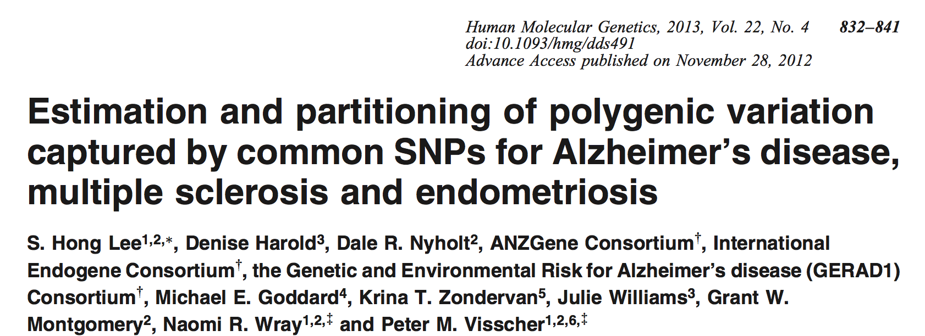
Demonstration of impact of consistent difference between cases and controls
Two control data sets – pretend one data set are “cases”
Both data sets called with the Illuminus calling algorithm
Data set 1 genotypes called also with Gencall
Solution -apply very stringent QC
- loses real signal as well as artefacts
- fit ancestry PC as covariates

Slide 16
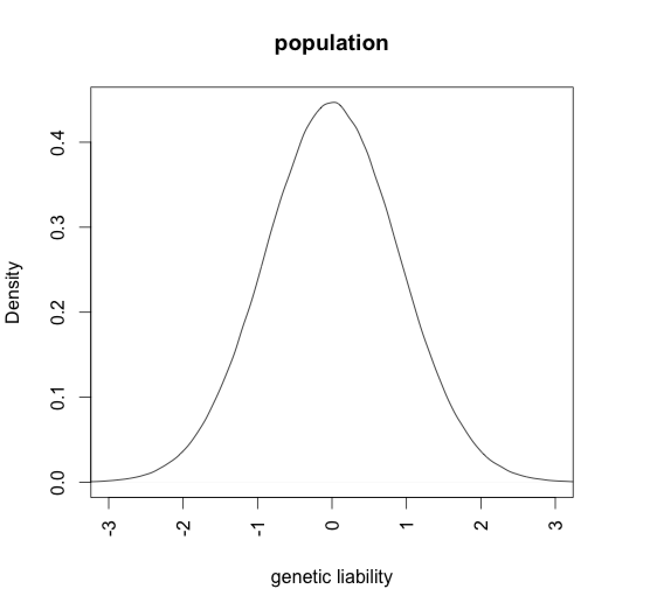
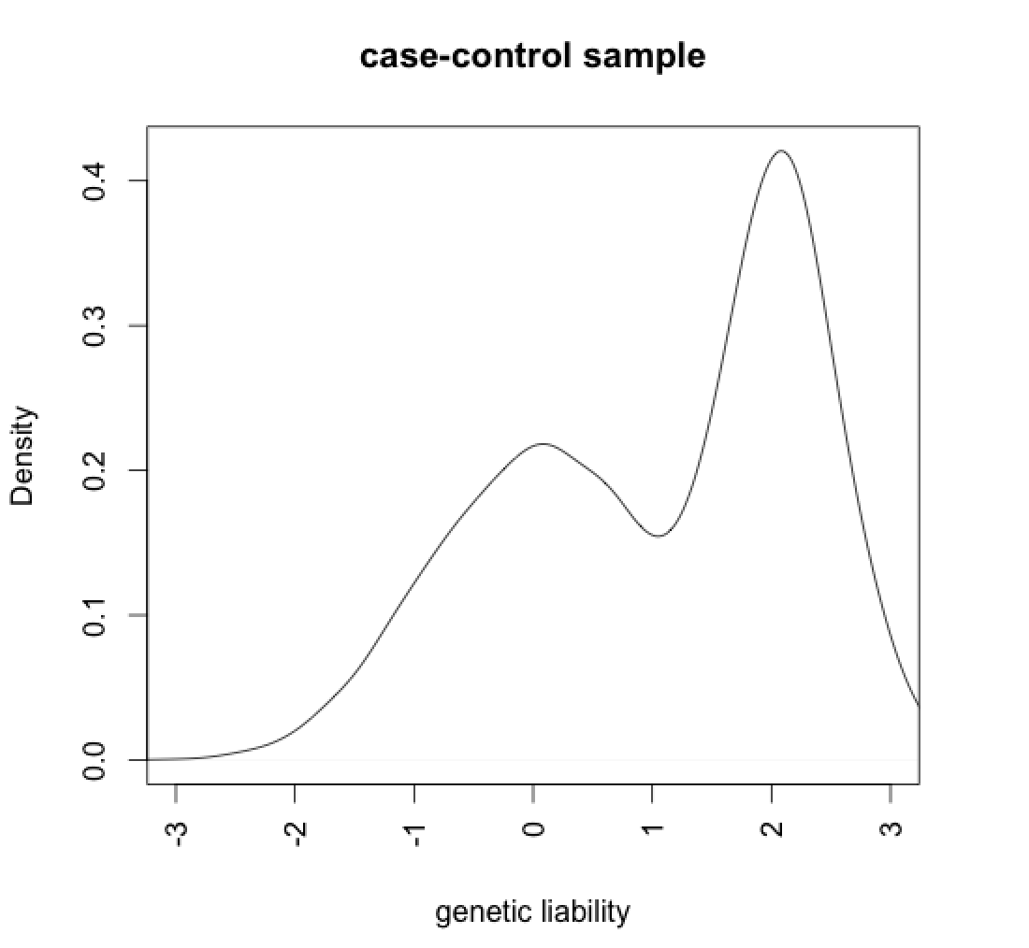


Problem 2- methodological
Scale
Convert estimate from 0/1 scale to liability scale
Scale + ascertainment
Cases highly over-represented
z
x
t
Prop: Unaffected (1-K)
Affected (K)
Prop: Control (1-P)
Case (P)
Robertson (1950)
Appendix of Dempster and Lerner (1950)

Slide 17
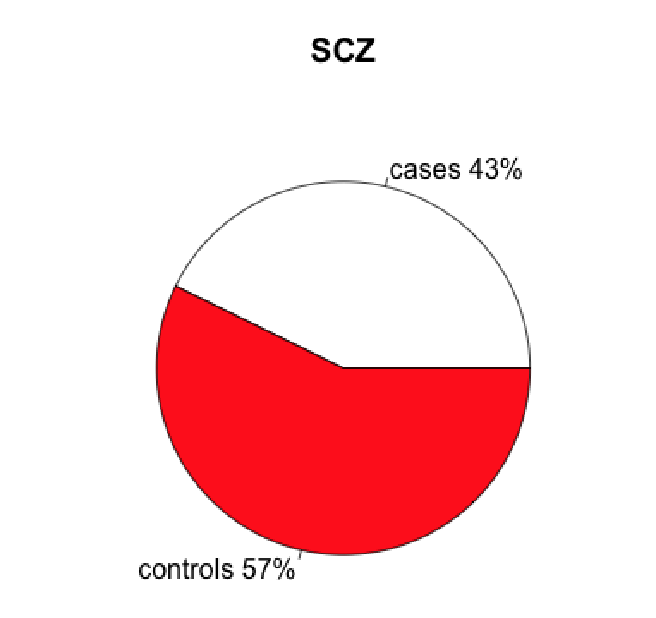
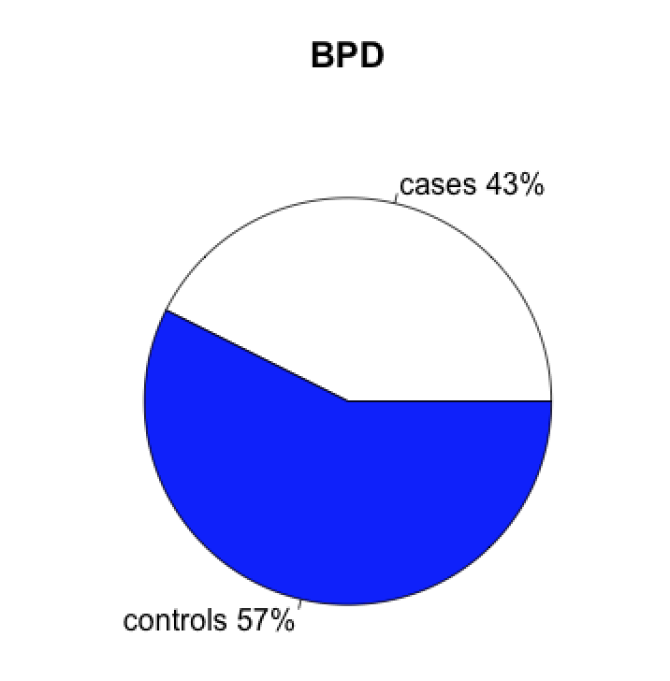
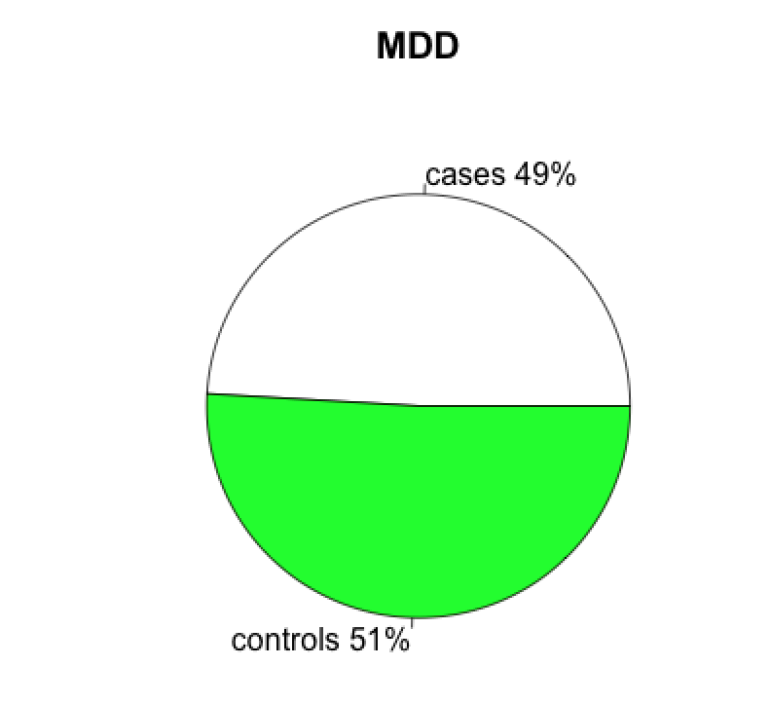
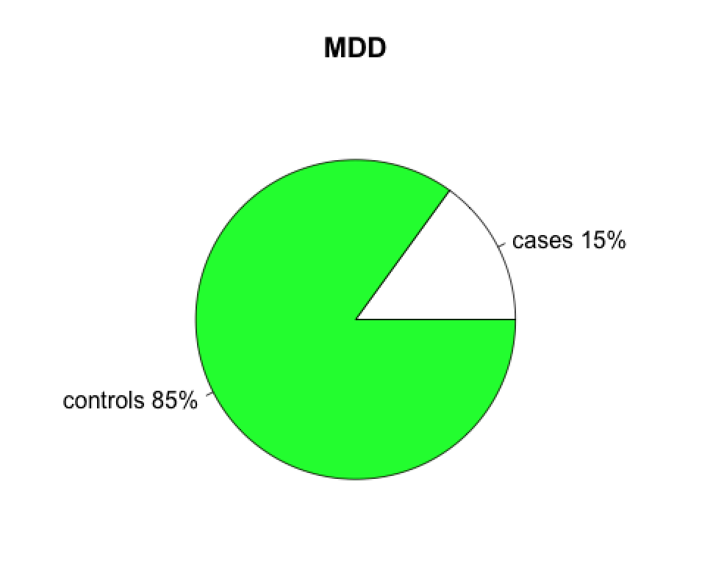
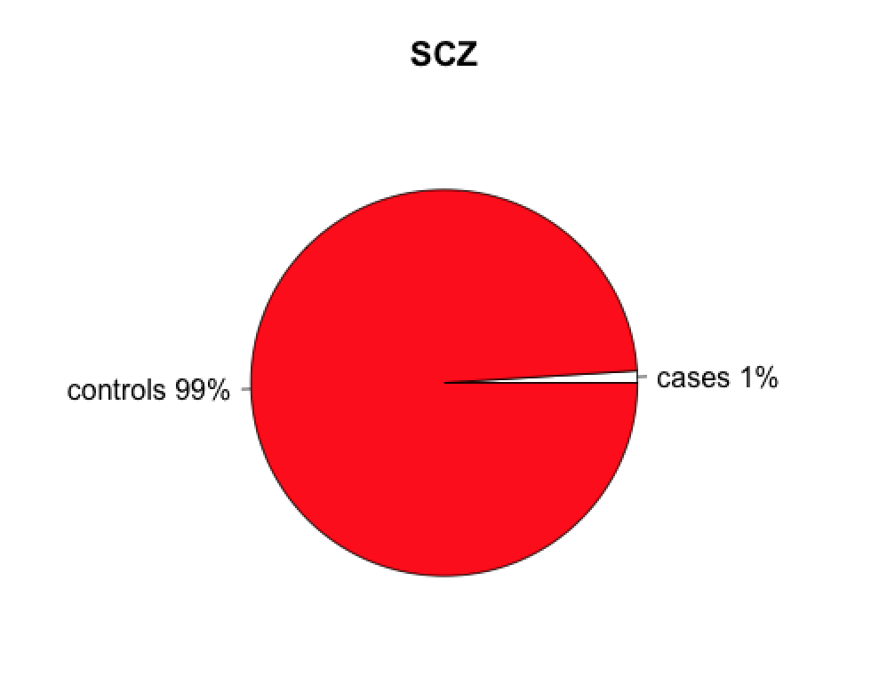
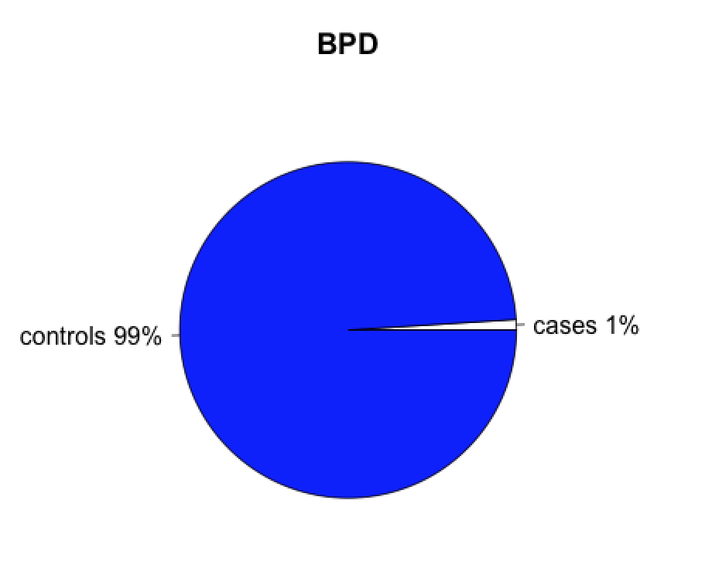
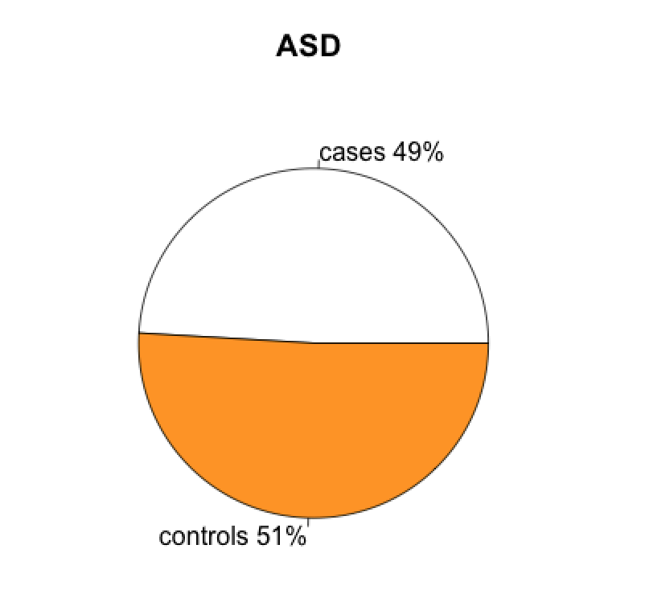
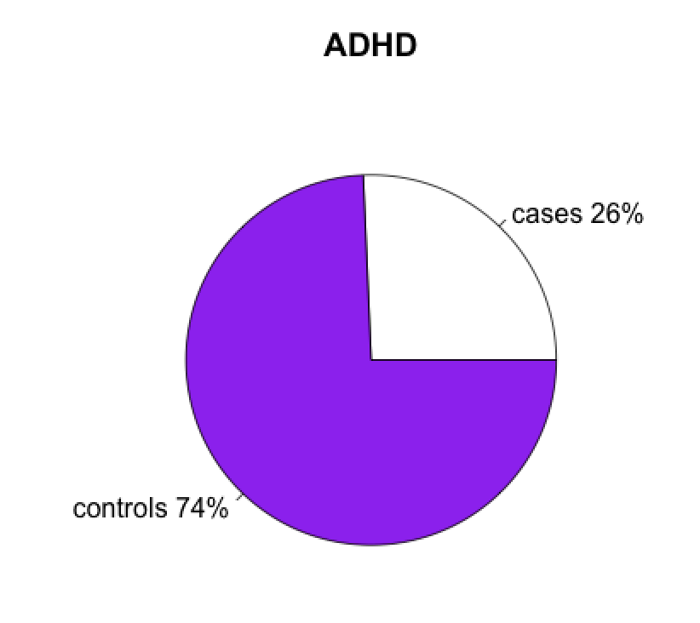
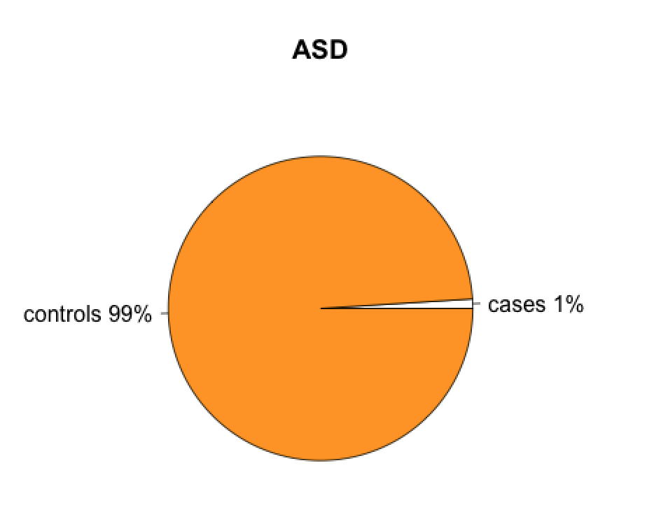
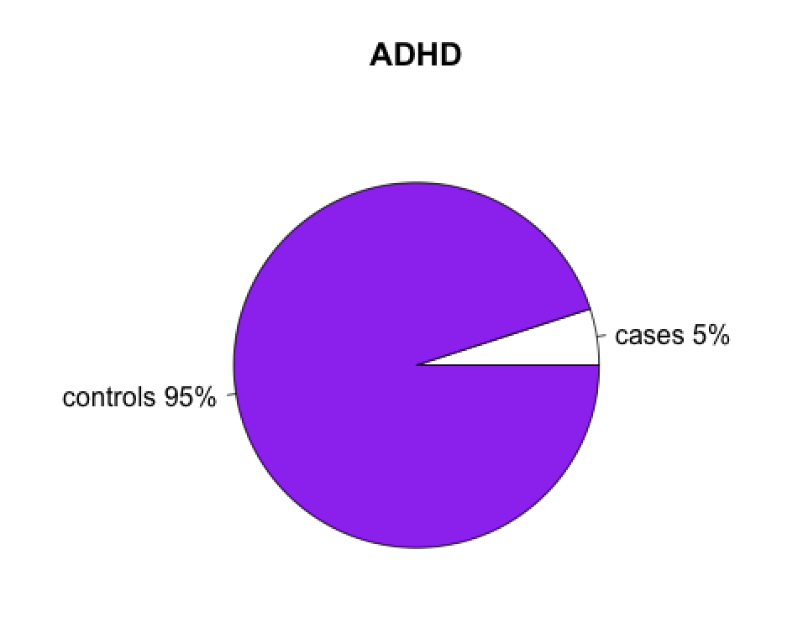
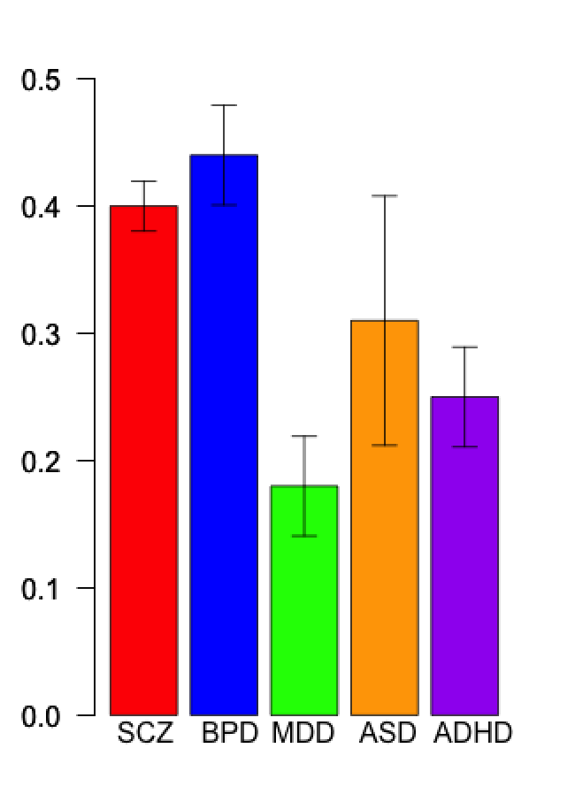
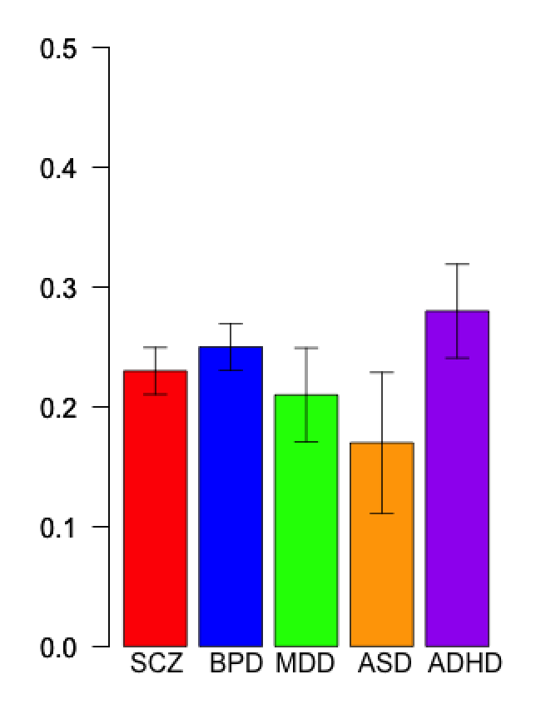
SNP-chip-heritability
Sample- cases (white): controls
Population-cases (white): controls
Assumption
What we estimate
What we report
Heritability of liability
Conclusions:
There is hiding heritability for these disorders.
We will identify more significantly associated SNPs as sample size increases.
Still a lot of hiding heritability
  Causal variants not tagged by SNPs
  From family studies are too high

Slide 18
What about power?
Power can be inferred by the standard error.
The s.e are a function of the data including sample size and proportion of cases and controls but are invariant to the value of the parameters that are estimated.
The sample size is reflected in the s.e estimated on the case-control scale
All SNP-heritabilities are highly significantly different from zero.
A s.e. of 0.02 implies that we would detect a SNP-heritability of 0.04 or greater as being signficantly different from zero.
A power calculator will be provided in GCTA.

Slide 19
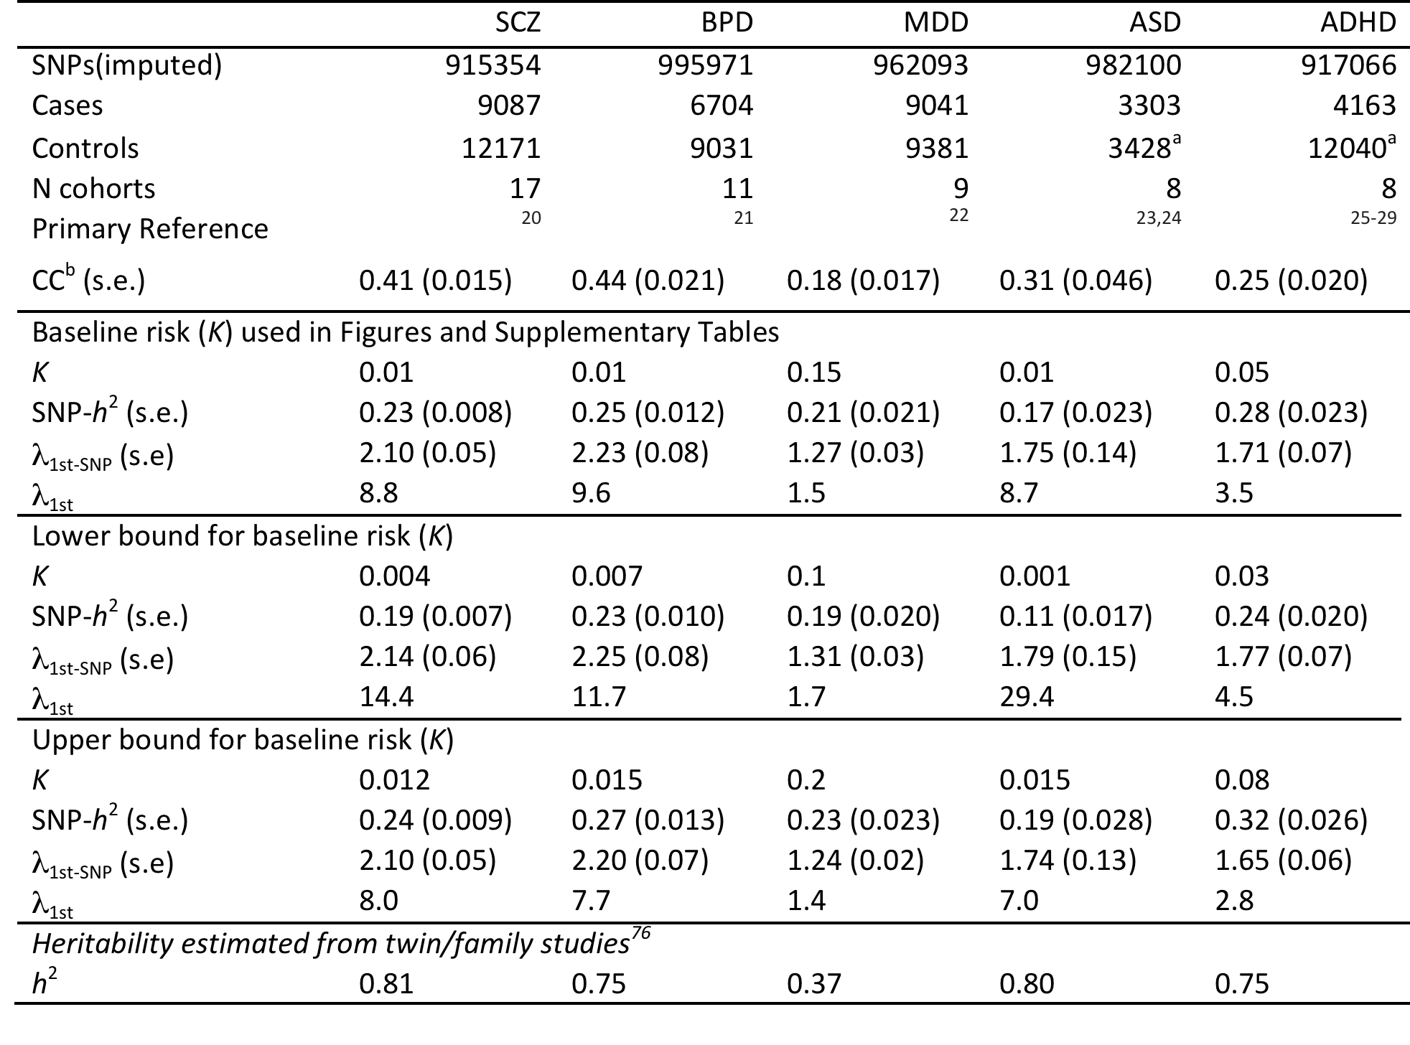
Table 1. Univariate analyses: sample description, SNP-heritabilities and recurrence risk to first-degree relatives
CC=SNP-heritability estimated on case-control scale. SNP-h² SNP-heritability on liability scale given assumed K. All estimates of SNP- are highly significantly different from zero. λ_{1st-SNP} recurrence risk to first degree relatives calculated from SNP-h² liability and K. λ_{1st} recurrence risk to first degree relatives calculated from h² from twin/family studies and K . a) some cohorts include cases and pseudo-controls where pseudo-controls are the genomic complements of the cases derived from genotyping of proband-parent trios.

Slide 20
Two key questions to progress our understanding of psychiatric disorders
What evidence can we provide that psychiatric disorders are like most other common complex disorders and that common variation contributes to the spectrum of genetic architecture
What evidence can we provide that there is a common genetic susceptibility to psychiatric disorders
Traditional approach for determining if disorders are genetically related
Collect cohorts of families measured for 2 disorders
  Difficult to get large cohorts
  Biases in ascertainment
  Even if highly heritability family history not common
  Only close relatives, so confounding with environment, e.g., interpretation of increased risk of depression in children of parents with schizophrenia?

Slide 21
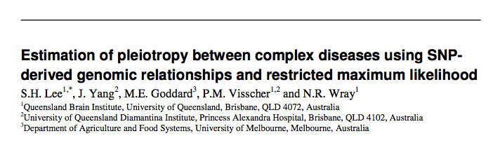
Bivariate models to estimate genome-wide pleiotropy between disorders
Two traits
Trait 1 = Cases and controls of disorder 1
Trait 2 = Cases and controls of disorder 2
Traits measured on different sets of people
– linked through genetic relationships
– are cases on one disorder more similar genetically of cases of the other disorder than to controls of the other disorder
Can explore genetic relationships between disorders that are simply not possible with family data
Low prevalence
Ascertainment
Confounding with common environment

Slide 22
Assessment of genome-wide pleiotropy
SNP-genetic correlation
Same on observed scale as on liability scale
  Not dependent on specified levels of disease prevalence
BUT interpretation
  Allele frequency spectrum
  r_{g}=cov/h₁h₂
SNP coheritability of liability
Covariance on the liability scale
r_{g}h₁h₂
If the two “traits” are different cohorts of the same disorder then SNP coheritability is an estimate of SNP-heritability

Slide 23
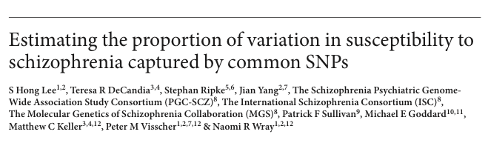
Bivariate models of the same disorder -SCZ
PGC-SCZ data
Divide into 3 subsets with approx equal cases and controls
Bivariate
  One subset = trait 1
  Another subset 2 = trait 2
Estimate
  SNP heritability trait 1
  SNP heritability trait 2
  SNP bivariate heritability trait 1/ trait 2
Genetic correlations between subsets are
  0.84, 0.89, 0.79 (s.e. 0.08)

Slide 24
Bivariate models of the same disorder
More heterogeneity between BPD and MDD subsets
Genetic correlation between subsets:
BPD: 0.67, 0.90, 0.55 (s.e. 0.10)
MDD: 0.65, 0.63, 0.38 (s.e. 0.15)
ADHD: 0.71 (s.e. 0.17)
ASD: 1.0 (s.e. 0.3)

Slide 25
Definition of subsets
SCZ
Sub1: ISC-Aberdeen, ISC-Cardiff, ISC-Dublin, ISC-Edinburgh, ISC-London, ISC-Portugal, ISC-SW1, ISC-SW2
Sub2: MGS
Sub3: SGENE-Bonn, SGENE-CH, SGENE-MUN, SGENE-TOP3, SGENE-UCLA, Cardiff, CATIE, Zucker Hillside
BPD
Sub1: BOMA, GSK, TOP, UCL, Edinburgh, Dublin
Sub2: GAIN&BIGS, STEP1, STEP2,Pritzer
Sub3: WTCCC
MDD
Sub1: GAIN, MDD2000-QIMR_610, MDD2000-QIMR_317
Sub2: GenRed, STAR*D, RADIANT(UK)
Sub3: RADIANT(GER)+Bonn/Mann., MPIP, GSK
ADHD
Sub1: CHOP,IMAGE, PUWMa included in³ and a Canadian cohort⁴ (all trio samples used to generate cases and pseudo controls)
Sub2: IMAGEII from³ and samples from UK⁵, Germany⁶ and Spain (genotyped on Illumina Omni1 and with clinical cohort described in⁷) (all case-control samples).
ASD
Sub1: AGP, AGP2
Sub2: CHOP, Finland, JHU, MonBos, SSC in two imputation cohorts (Illumina Infinium 1Mv3 (duo) and Illumina Infinium 1Mv1).

Slide 26
Bench-marking genetic sharing across disorders
Genetic correlation:
  SCZ/BPD 0.68 (s.e. 0.04)
  SCZ/MDD 0.43 (s.e. 0.06)
  BPD/MDD 0.47 (s.e. 0.06)
  MDD/ADHD 0.32 (s.e 0.07)

Slide 27
Sanity Check- Crohn’s Disease
5k cases 11k controls
A priori unlikely that Crohn’s and psychiatric disorders share genetic factors
Same QC pipeline as psychiatric disorders

Slide 28
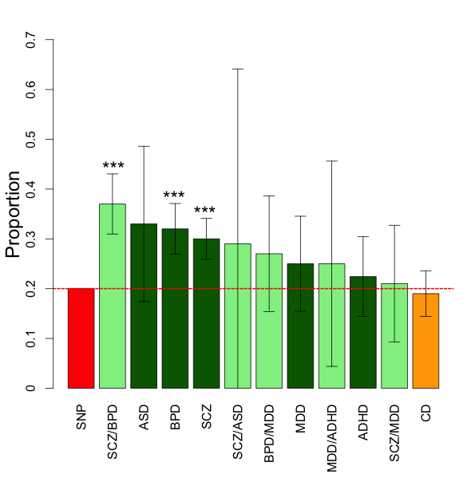
Annotation of SNPs to genes
Fit 3 genome relationship matrices
SNPs in CNS+ genes (20%)
SNPs in other genes (40%)
SNPs not in genes (40%)
Estimate 3 variance components
Supplementary Table 3

Slide 29
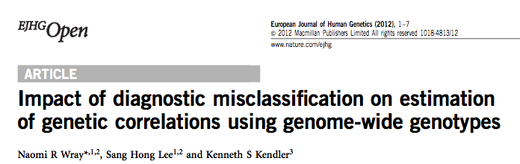
Impact of misclassification
15% of those first diagnosed with BPD end with a stable diagnosis of SCZ
5% of those first diagnoses with SCZ end with a stable diagnosis of BPD
Bromet et al (2011),Laursen et al (2011)
This level of misclassification would generate an estimated genetic correlation of ~ 0.15 if the true genetic correlation was 0.
Unlikely to have this level of misclassification in GWAS samples
A true genetic correlation between disorders is consistent with diagnostic overlap

Slide 30
Bias because of non-independence of collection of samples

Slide 31
Exclude SCZ samples that include schizoaffective disorders

Slide 32
Exclude community MDD samples

Slide 33
Partitioning variance by minor allele frequencies of SNPs
Create 5 relationship matrices based on MAF of SNPs (<0.1,0.1-0.2,0.2-0.3,0.3-0.4,0.5)
Does it makes sense that the relationship matrices are different?
  For close relatives estimated relationships based on SNPs with different MAFs would be comparable.
  For very distant relatives have inherited chromosome segments from distant common ancestors.
  If a SNP is more recent than the common ancestor, then the relationship between these individuals would not be reflected by the SNP, and SNPs with low MAF tend to be more recent than SNPs with high MAF.

Slide 34
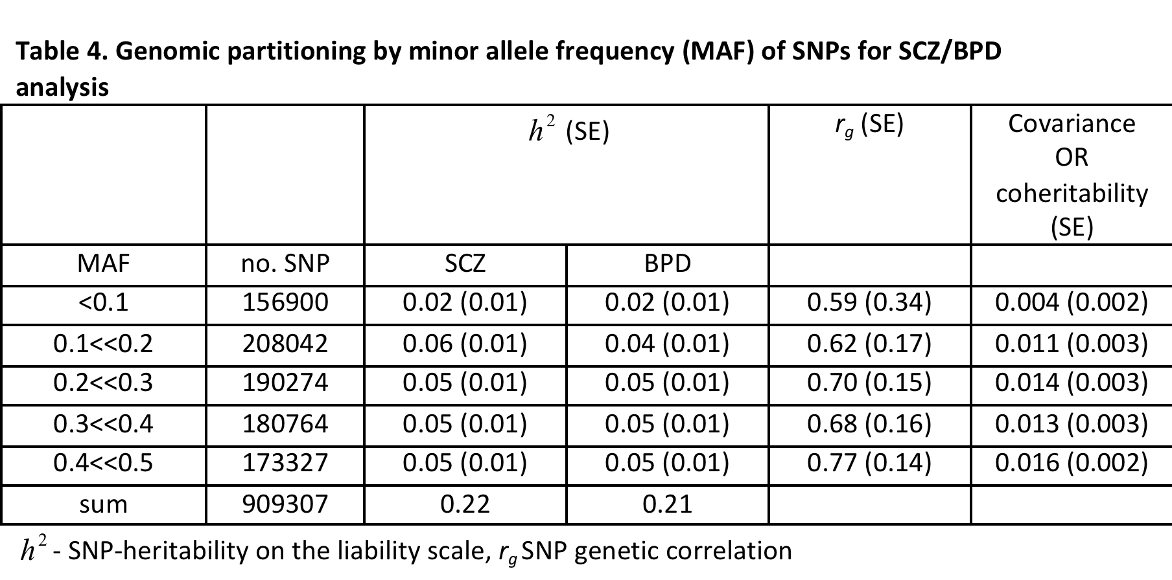
Analysis by MAF
Less variance explained by < 0.1 bin reflects less SNP representation
Simulations suggest variance attributable to common SNPs is likely to reflect common causal variants not rare causal variants

Slide 35
By chromosome analysis
Fit 23 genomic relationship matrices - SCZ

Slide 36
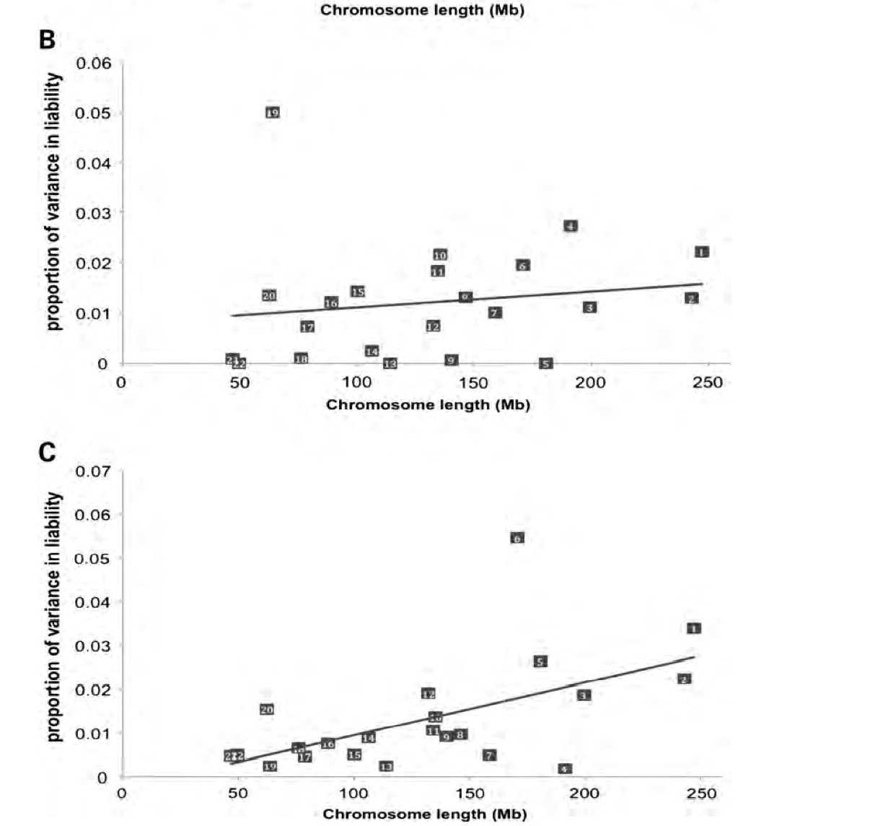
By chromosome analysis Alzheimer’s Disease and Multiple Sclerosis
Chromosome 19, APOE
Chromosome 6, MHC

Slide 37
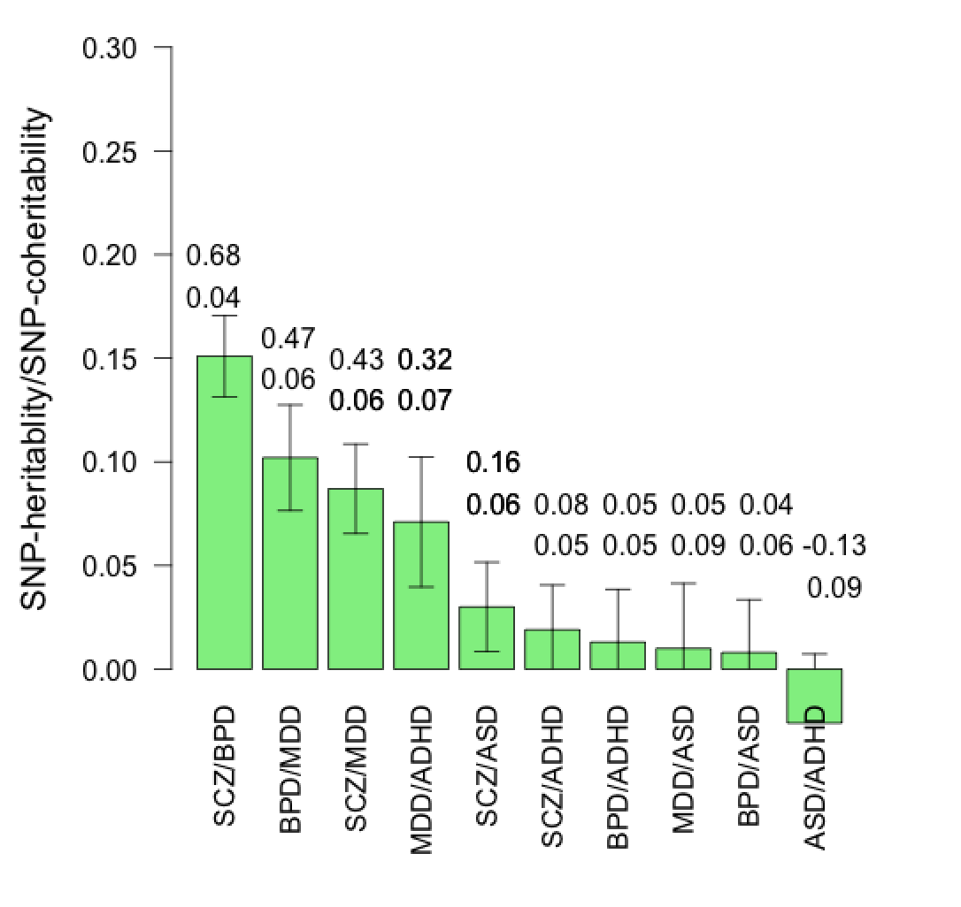
Interpretation/benchmarking of shared relationships between disorders….tricky
Relationship between SNP-correlation and genetic correlation?
Depends on frequency spectrum of causal variants
Could have high correlation, but very low SNP correlations
Both SNP-correlation and genetic correlations represent an average across the genome.
Family studies usually don’t report genetic correlation, they report increased risk to family relatives (because cant separate genetic and environment contributions)
We can convert rg to increased risk to relatives
  But remember this is to provide a benchmark
  Assumptions…
For example a high SNP- correlation between SCZ and BPD could imply …

Slide 38
Interpretation 1
SCZ/BPD 0.68 (s.e. 0.04)
Implies risk to 1st-degree relatives of 4.7
r_{g} =0.60 (9 million records from 2 million families, Lichtenstein et al, 2009)
Many estimates of increased risk to first degree relatives of 2.1 (~r_{g} 0.3)
  BPD/MDD 0.47 (s.e. 0.06)
Implies risk to 1st-degree relatives of 1.6
Many estimates of increased risk to first degree relatives wide range
SCZ/MDD 0.43 (s.e. 0.06)
Implies risk to 1st-degree relatives of 1.6
Many estimates of increased risk to first degree relatives of 1.5 (~r_{g} 0.4)
MDD/ADHD 0.32 (0.07)
Implies risk to 1st-degree relatives of 1.3
SCZ/ASD 0.16 (0.06)
Implies risk to 1st-degree relatives of 1.3
Surprising that not sig different from zero for
BPD/ADHD Faraone et al meta-analysis 2012, risk to 1st-degree relatives of 2.6 just BPI?
ASD/ADHD

Slide 39
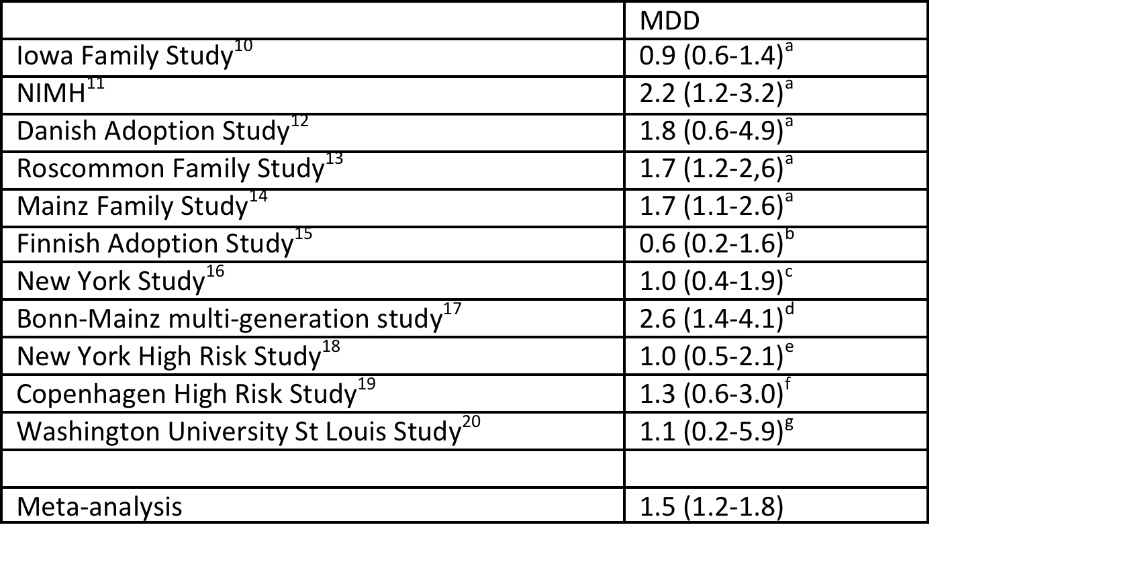
SCZ-MDD
Supplementary Table 10. Meta-analysis of the relative risk (odds ratio) for schizophrenia and MDD (unipolar disorder) among first-degree relatives of schizophrenic probands in controlled family studies

Slide 40
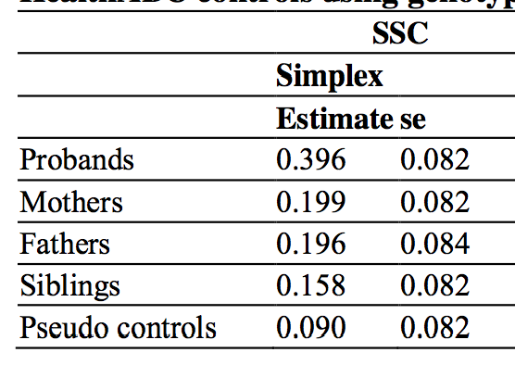
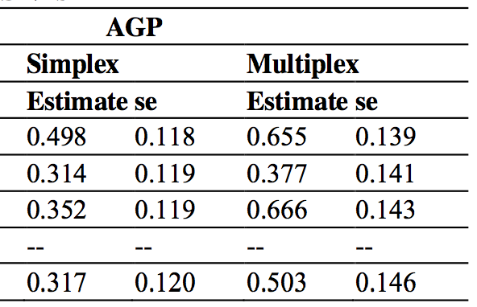

Autism data
Mum
Dad
Proband
Pseudo-control = parental genomic complement
Good design for avoiding any problems of population stratification
Klei et al (2012) Common genetic variants, acting additively, are a major source of risk for autism Molecular autism

Slide 41

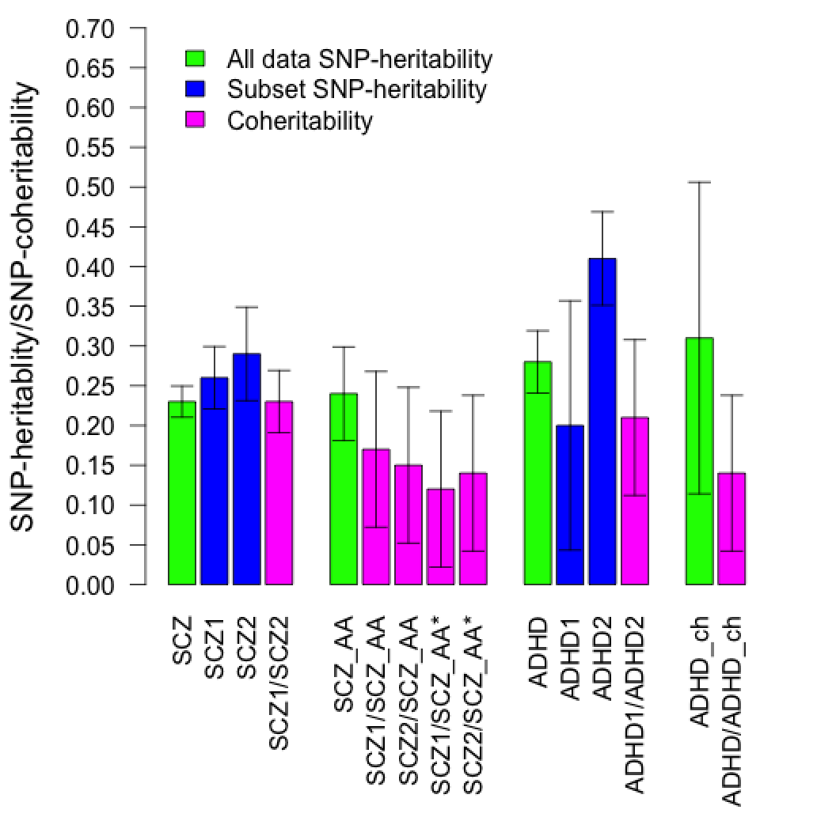
Cross-ethnicity
Matt Keller & Teresa Di Candia
University of Boulder
Molecular Genetics of SCZ Consortium
International SCZ Consortium

Slide 42

Cross-ethnicity
Matt Keller & Teresa De Candia
University of Boulder
Molecular Genetics of SCZ Consortium
International SCZ Consortium
Steve Faraone
SUNY Upstate Medical School
PGC-ADHD

Slide 43
Epidemiological puzzles
Rates of schizophrenia are lower in people with rheumatoid arthritis and vice versa
Smoking is a risk factor for RA, and smoking rates in SCZ are high
Observation seems to hold when controlling for obvious confounders
Immune theory of schizophrenia
Very difficult to determine from family studies if this is a genetic link

Slide 44
Big Picture
Cost-effective use of current data to guide and motivate future studies
Provides motivation to increase sample sizes
  First SCZ results presented at Athens World Congress of Psychiatric Genetics in 2010
  PGC-MDD 100K aiming for cases: 100K controls
  Need 5 times sample size for MDD as for SCZ
  Trio designs not a good idea for multiplex families or when there may be assortative mating
Provides insight into genetic architecture
Important sharing of common variants between disorders
Important sharing across ethnicities
Phenotyping is becoming the limiting factor

Slide 45
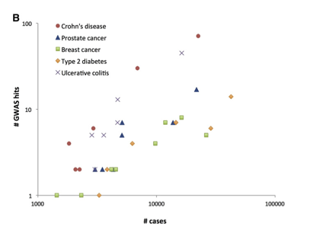
PGC-SCZ: 31K cases, 38K controls
Visscher et, al, 2012
AJHG Five Years of GWAS discovery

Slide 46


Acknowledgements
Uo Queensland
Hong Lee
Peter Visscher
Jian Yang
VCU
Ken Kendler
UoMelbourne
Mike Goddard
UoBoulder
Matt Keller
Teresa de Candia
International Psychiatric Genomic Consortium
  320 scientists from 19 countries
  Stephan Ripke
  Ben Neale
  Shaun Purcell
  Steve Faraone
  Jordan Smoller
  Roy Perlis
  Bryan Mowry
International Inflammatory Bowel Disease Genetics Consortium

