Slide 1
PGC Worldwide Lab Call Details
DATE: Friday, January 11th, 2013
PRESENTER: Mark Daly, PhD, Chief Analytic and Translational Genetics Unit MGH
TITLE: “Looking ahead in gene discovery for psychiatric disorders - lessons from
GWAS and sequencing in autism and inflammatory bowel disease”
START: We will begin promptly on the hour.
1000 EST - US East Coast
0700 PST - US West Coast
1500 GMT - UK
1600 CET - Central Europe
0200 EDT – Australia (Sat, January 12th, 2013)
DURATION: 1 hour
TELEPHONE:
- US Toll free: 1 866 515.2908
- International direct: +1 617 399.5122
- Toll-free number? See http://www.btconferencing.com/globalaccess/?bid=75_public
- Operators will be on standby to assist with technical issues. “*0” will get you assistance.
- This conference line can handle up to 300 participants.
PASSCODE: 532 018 64

Slide 2
Lines are Muted NOW
Lines have been automatically muted by operators as it is possible for just one person to ruin the call for everyone due to background noise, electronic feedback, crying children, wind, typing, etc.
Operators announce calls one at a time during question and answer sessions.
Dial *1 if you would like to ask a question of the presenter. Presenter will respond to calls as time allows.
Dial *0 if you need operator assistance at any time during the duration of the call.

Slide 3



Looking ahead in gene discovery in psychiatric disorders
A view from the frontlines of GWAS and exome sequencing in IBD, autism and schizophrenia
PGC Worldwide Lab Meeting – January 2013
Mark Daly
Chief, Analytic and Translational Genetics Unit, MGH
Associate Professor of Medicine, HMS
and
Co-director, Medical and Population Genetics Program
Faculty Member, Stanley Center for Psychiatric Research
Broad Institute of MIT and Harvard

Slide 4
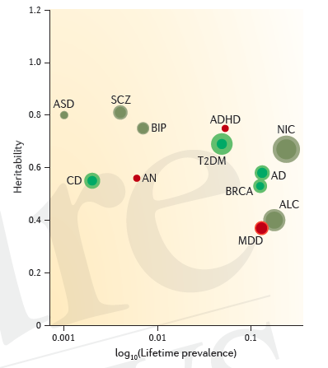
Heritability of common diseases is consistent and indisputable…
Sullivan, Daly, O’Donovan 2012

Slide 5
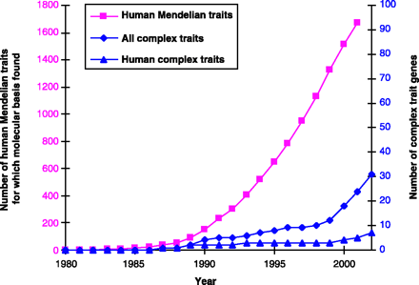
…yet linkage and candidate gene association did not provide durable insights
Glazier, Nadeau and Aitman, Science 2002
Dark Ages of complex trait genetics

Slide 6
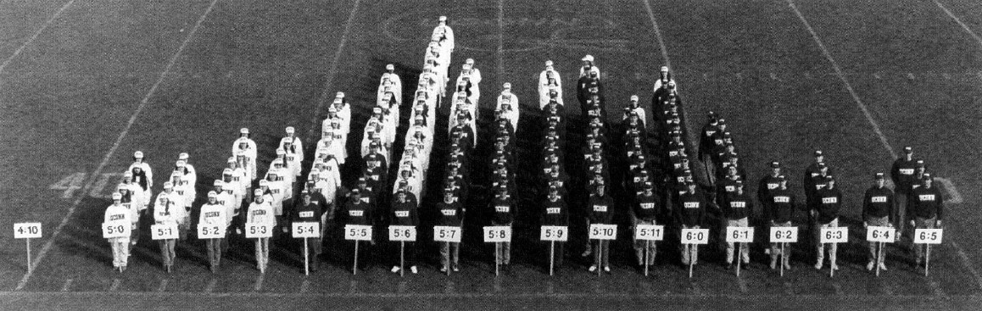
Explanations not difficult to come by
Many genes vs. 1
Incomplete
Penetrance
phenotype₁
other
genes
“We suggest that evolutionary changes in anatomy and way of life are more often based on changes in the mechanisms controlling the expression of genes than on sequence changes in proteins. We therefore propose that regulatory mutations account for the major biological diﬀerences between humans and chimpanzees.” –
King & Wilson. Science. April, 1975.
phenotype₂
genotype
phenotype₃
disease state
phenotype₄
phenotype₅
Exposures / environment

Slide 7
Three major elements turned the tide
1. Genome Resources (HGP, HapMap, 1KG)
2. Technology (chip & NGS)
3. Collaboration

Slide 8
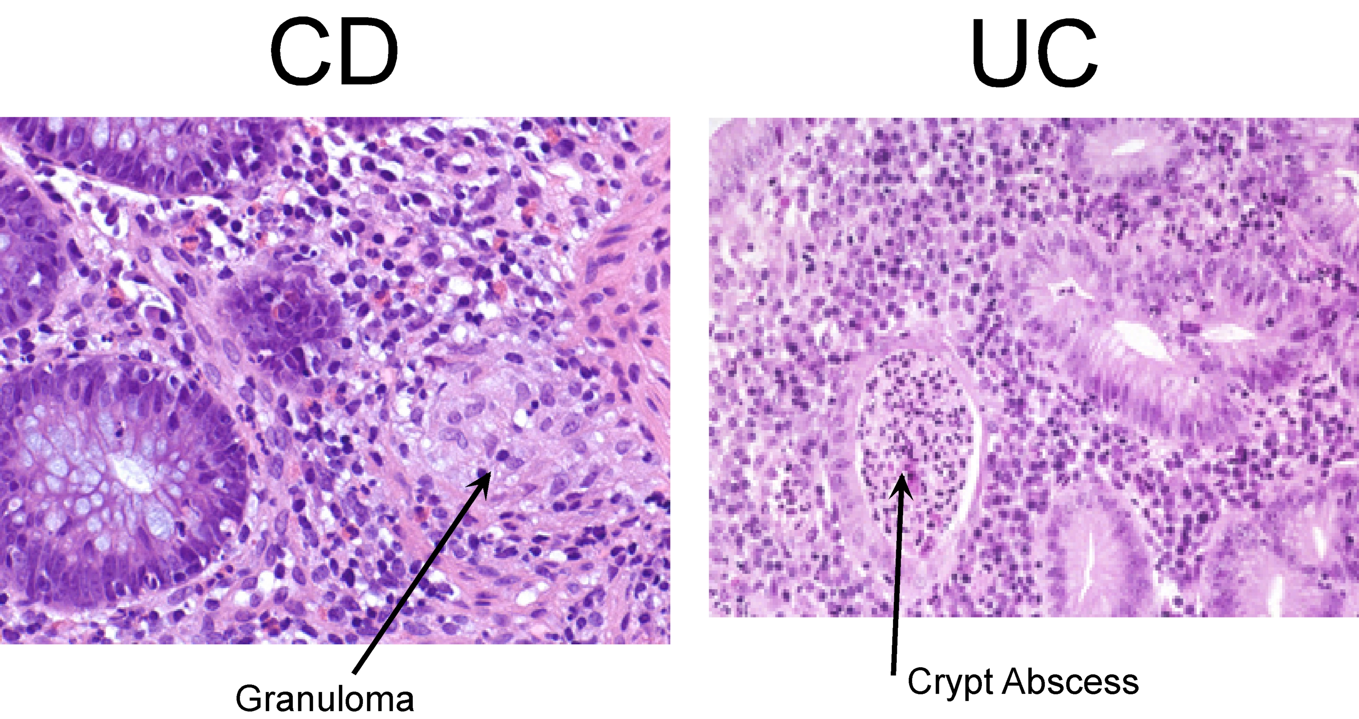
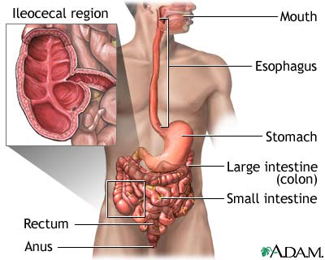
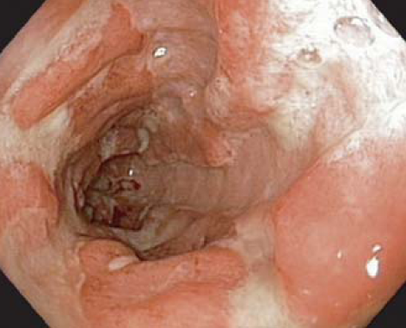
Inflammatory
Bowel Disease:
Crohn’s Disease (CD)
&
Ulcerative Colitis (UC)
Chronic, heritable inflammatory diseases of the gastrointestinal system.
2000: 0 genes known
2005: 2 genes known
Only a tiny fraction of the
heritability understood
Notes:
8

Slide 9
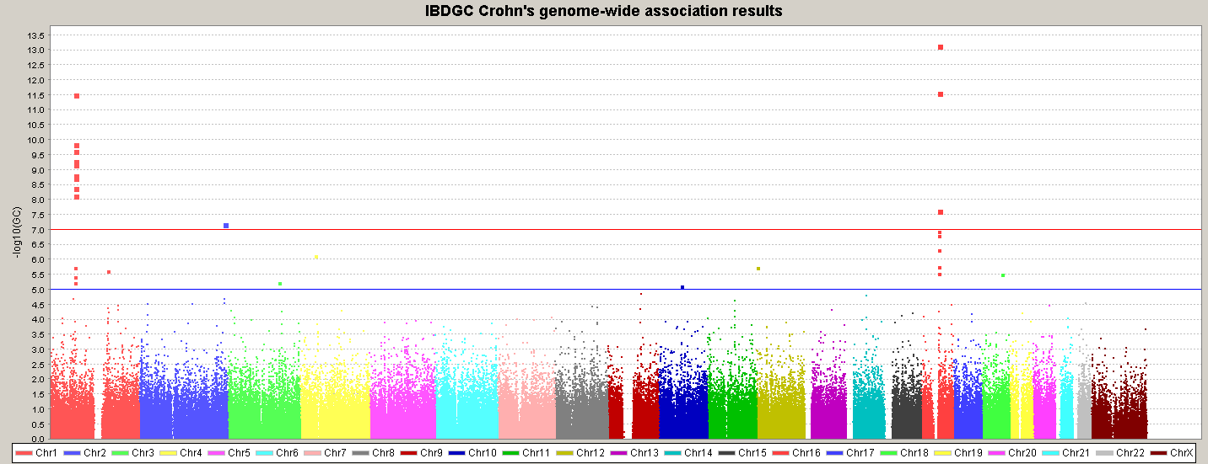
First Genomewide Association Results – 2006
N ~ 1000 cases, 1000 controls
Previously Found by Linkage
NOT Found by linkage
NOD2/CARD15
IL23R
ATG16L1
IBD5
10q
New scales of computational tools required to manage and analyze these data

Slide 10
Individual GWA studies – Crohn’s
5p13
10q21
3p21
PTPN2
IRGM
IL12B
NKX2-3
NOD2
5q31
IL23R
ATG16L1
TNFSF15
2000 2001 2002 2003 2004 2005 2006 2007 2008
Notes:
We today have 47 regions confirmed for T2D and Crohns -- up from 5 two years ago.
We need a high throughput approach to go from a locus to genes and mutations

Slide 11
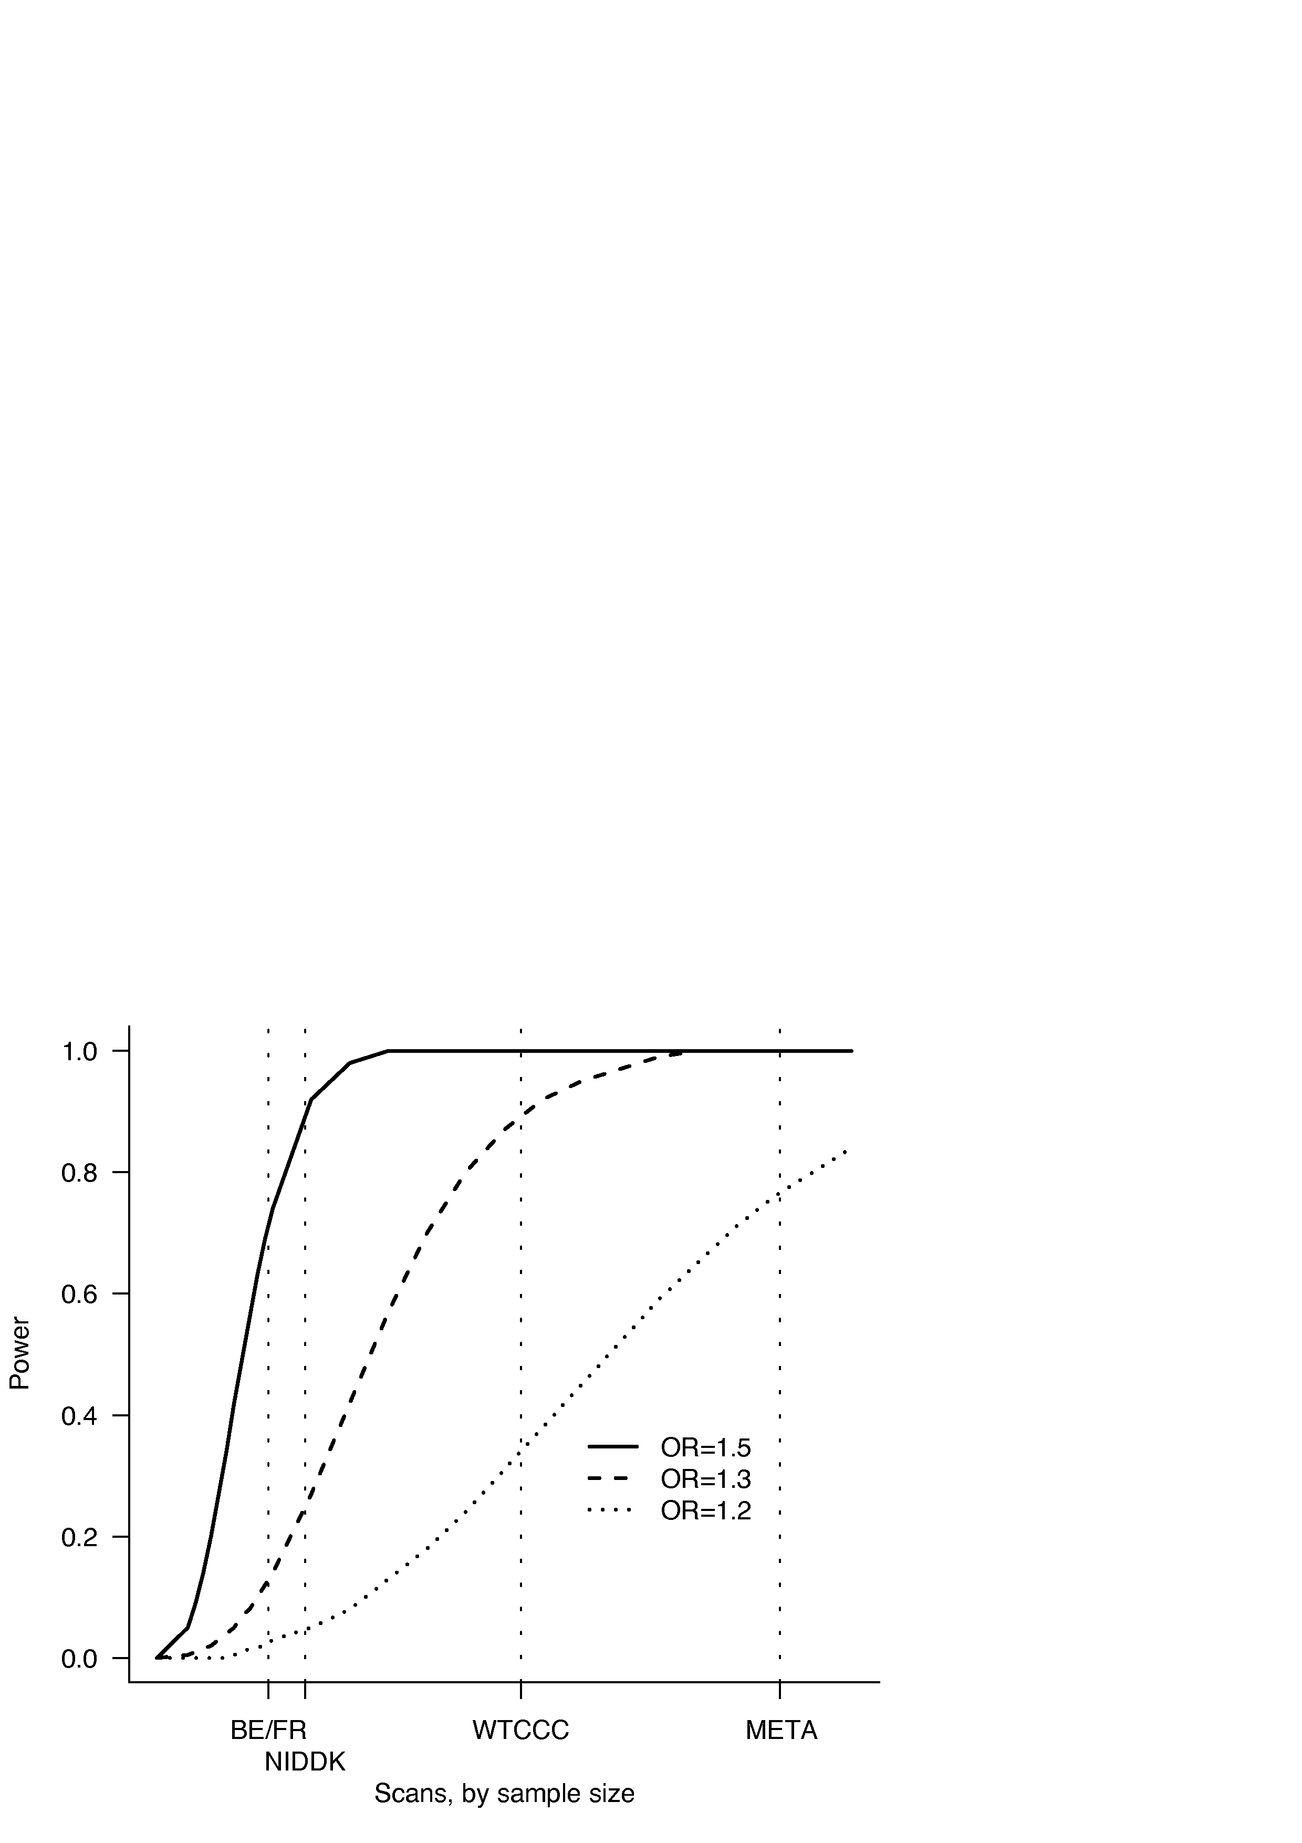
Combining studies yields greater power
Opportunity: by combining three published studies, we reap the power of an 4000/4000 sample GWAS
Nearly all progress in GWAS has been the result of multiple study meta-analysis
(Example – associated SNP with MAF = 0.20)

Slide 12

Fundamental change 3: Collaboration
International IBD Genetics Consortium

Slide 13
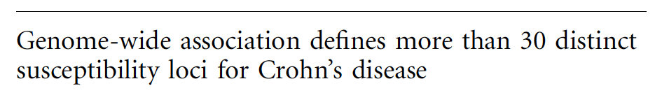
Crohn’s Disease: Barrett et al 2008
32 genome-wide significant hits defined – p<5x10⁻⁸
Each study performed slightly different depth of follow-up but approximately:
N=1000 cases, 3 hits
N=2000 cases, 9 hits
N=4000 cases, 32 hits
Oddly enough, each new 1000 cases was seemingly more valuable than the previous…

Slide 14
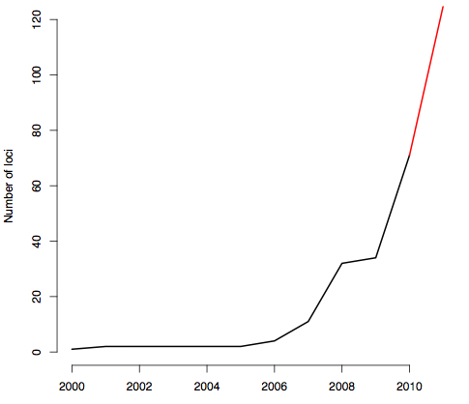
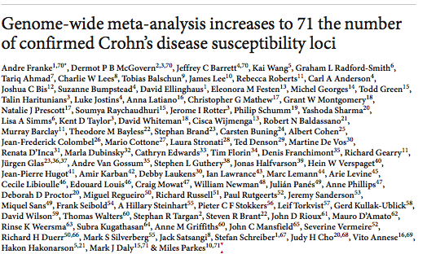
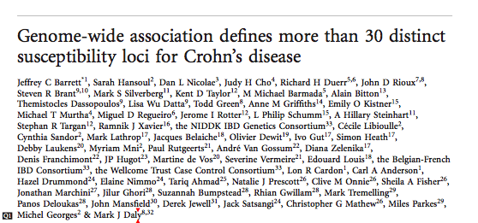
Crohn’s Disease and Ulcerative Colitis:
Jostins, Ripke et al 2012
Jostins, Ripke et al
Nature, November 1 2012
163 distinct confirmed associated loci in IBD
(CD and/or UC)
N=75,000 samples

Slide 15
Crohn’s Disease and Ulcerative Colitis:
Jostins, Ripke et al 2012
Jostins, Ripke et al
Nature, November 1 2012
163 distinct confirmed associated loci in IBD
(CD and/or UC)
N=75,000 samples
All 32 of the Barrett et al 2008 GWS hits are confirmed and more significant than they were in 2008

Slide 16
“All science is either physics or stamp collecting”
Ernest Rutherford

Slide 17
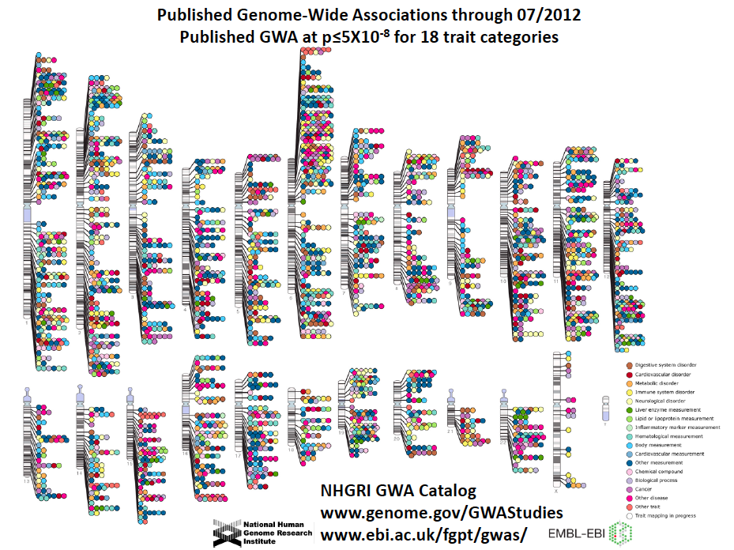
A damn fine stamp collection…

Slide 18
…but that is what it is
Goal of GWAS was to inform on the biology of disease in an actionable fashion
So how do we get there?

Slide 19
General Challenge
Most associations do not identify specific genes and causal mutations – just pointers to small regions with causal influences on disease.
In order to develop and act on a therapeutic hypothesis, we must go much further
Key Questions
  Which gene is connected to disease?
  What biological process is thereby implicated?
  What is the cellular context in which that process acts and is relevant to disease?
  What are the specific functional alleles which perturb the process and promote or protect from disease?

Slide 20
Parallel tracks
Bottom up
  Traditional approach of pursuing an individual association result to articulate the molecular impact of risk variation and how it acts to promote disease
Top down
  Utilize the complete set of GWAS results to identify common pathways/processes implicated in disease pathogenesis

Slide 21
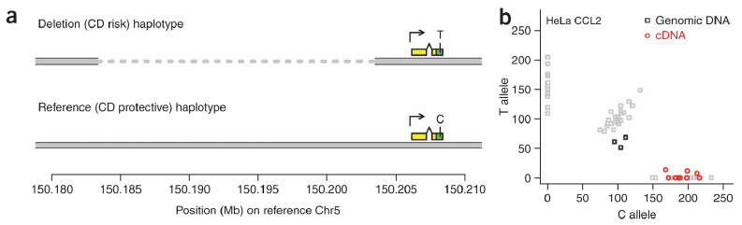
Early GWAS results implicate autophagy via
ATG16L1, IRGM
2007
Multiple GWAS studies identify common Thr300Ala variant of ATG16L1 as associated with CD
Noncoding variation at IRGM, later traced to 20 kb promoter CNV
n.b., prior to first GWAS, 0 references on
Crohn’s and autophagy

Slide 22


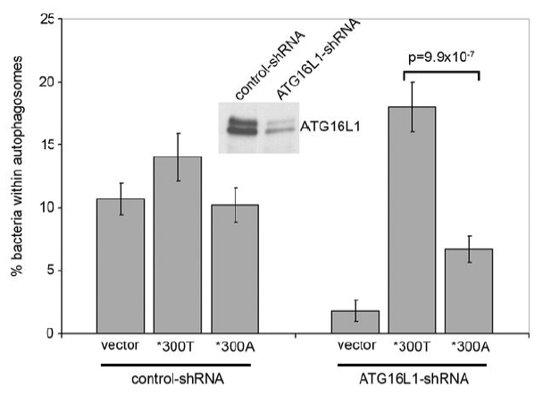
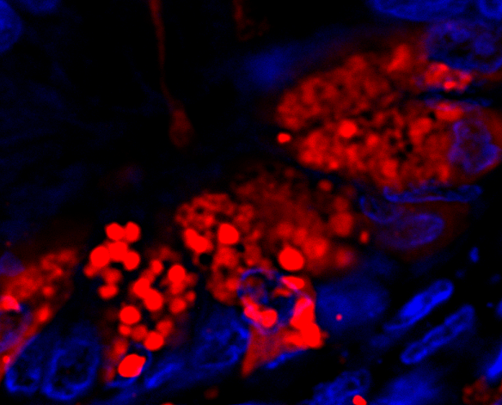

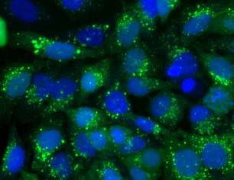
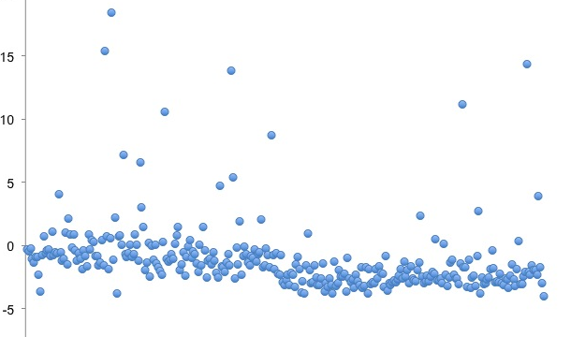
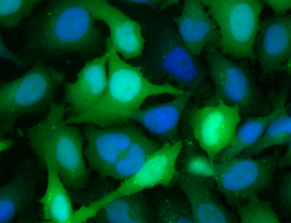
Patient-guided drug discovery for Crohn’s Disease: autophagy
Patient/environmental factors
Medicines
Discovery of disease genes, microbial triggers
Identification of disease pathways driven by human disease genes
Modeling disease pathways in animals and patients
Testing therapeutic
hypotheses with small molecules in animals and patients
Discovery and optimization
of new medicines to improve clinical outcomes
Clinical testing in patients
Healthcare
delivery
T300A
Number of vesicles/cell
T300A specific paneth
cell defect in patients
Compound
Allele-specific impairment in vitro

Slide 23
What about the top-down approach?
Can we implicate specific genes and pathways from GWAS results

Slide 24
Hypothesis: Many associated genes implicate limited number of pathways
Proof: Statistically significant excess
connectivity of genes in GWAS regions

Slide 25
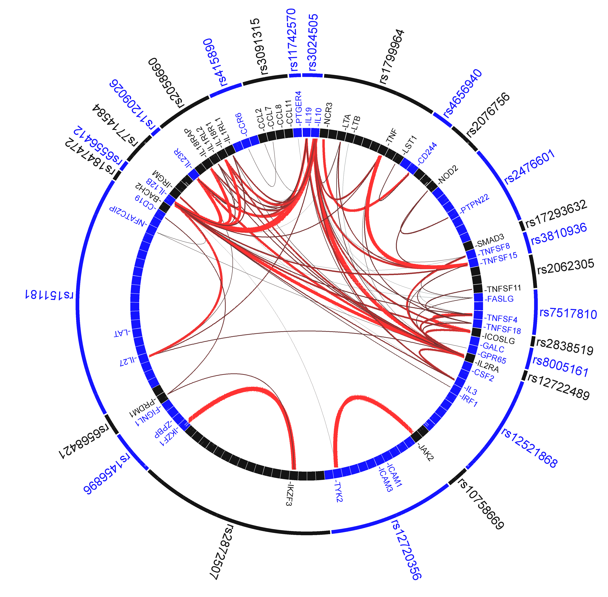
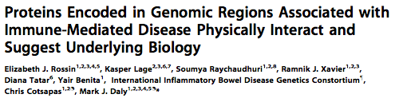
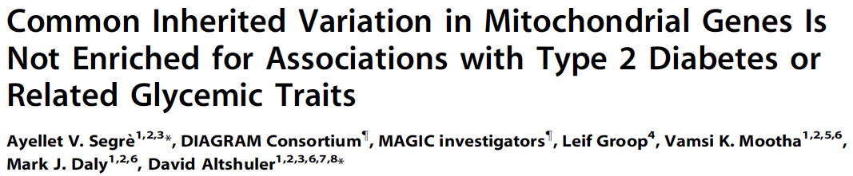
Computational tools enable the integration of ‘human genetic screens’ with other genome-scale screening data
DAPPLE
GRAIL plot from Franke et al 2010
MAGENTA

Slide 26
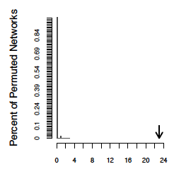
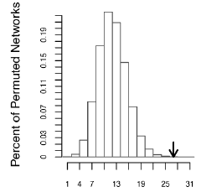
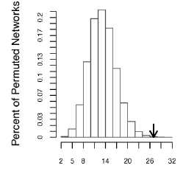
PPI Networks identify specific genes and pathways
Fanconi anemia
9 synthetic loci
Rheumatoid arthritis
27 loci
Crohn’s disease
25 loci
Direct connectivity
p << 2x10⁻⁵
Direct connectivity
p = 3x10⁻⁴
Direct connectivity
p = 1.11x10⁻³
Notes:
What I am not showing here is that the method also allows us to score individual proteins in the network. This is relevant to most loci, which contain numerous genes.

Slide 27
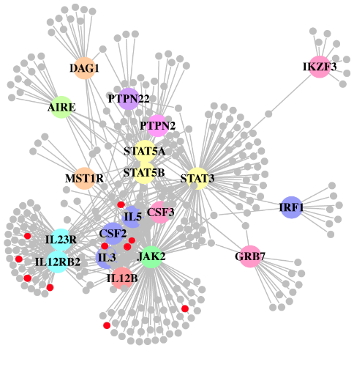
Validation of PPI networks
Further experimental support that the non-random networks
are truly implicating the underlying genes
Scores
per
tissue
Tissue
Network genes are co-expressed
Connected proteins are enriched for newly confirmed associated genes (p=6.5x10⁻⁴)

Slide 28
Many Crohn’s associations shared with other diseases
PTPN2: type 1 diabetes
CDKAL1: type 2 diabetes
GCKR: triglycerides, CRP levels
IL23R: Psoriasis, ankylosing spondylitis
ORMDL3: asthma
PTGER: multiple sclerosis
PTPN22: same coding variant which is strong risk factor for T1D, RA is protective against Crohn’s
Critical clues to biology reside in these shared components

Slide 29
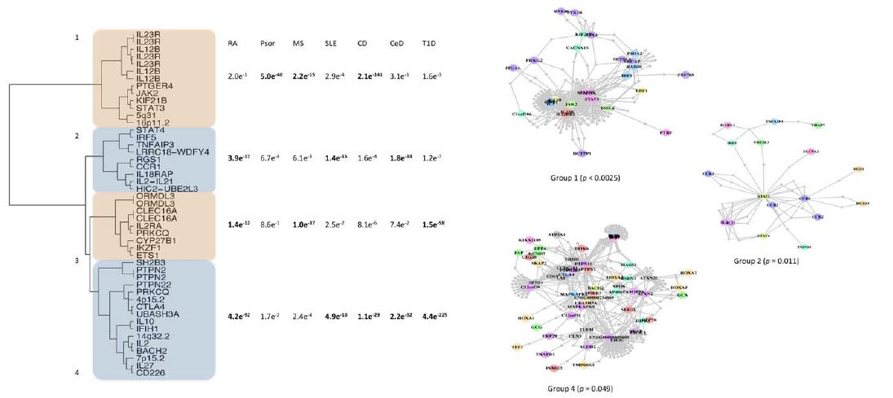
Cross-disease information
Genes coordinately associated to multiple disease are tightly functionally linked
Cotsapas et al, August 2011 PLoS Genetics

Slide 30
Modeling Crohn’s vs. UC
With the new combination of all GWAS data we
can utilize likelihood-based analyses to determine
how many loci are best explained by:
example:
Generic IBD risk factors (CD=UC): 50 CARD9
Crohn’s only risk factors (UC=control): 30 NOD2, ATG16L1
UC only risk factors (CD=control): 23 RNF186
Loci affecting both diseases but with
different strengths of effect (saturated model): 60 IL23R
Majority of loci (110/163) defined affect both diseases

Slide 31
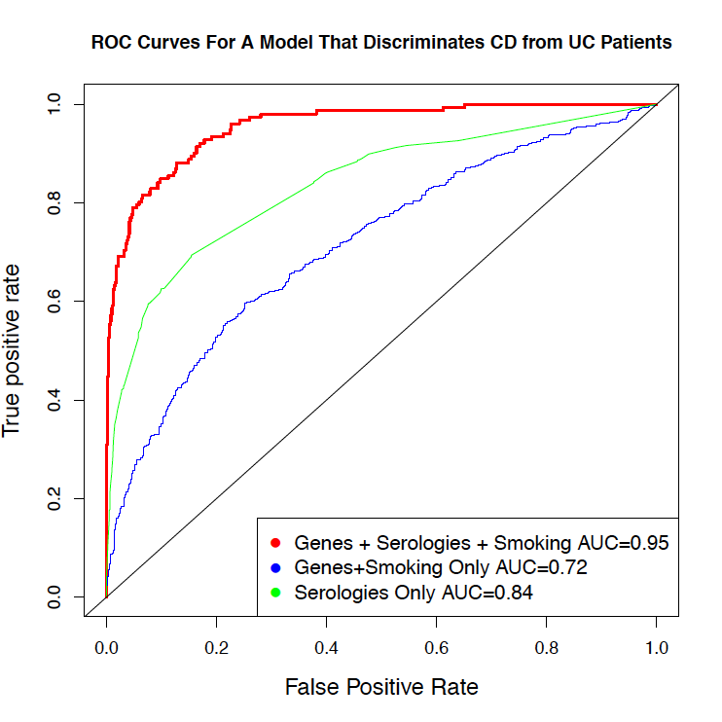
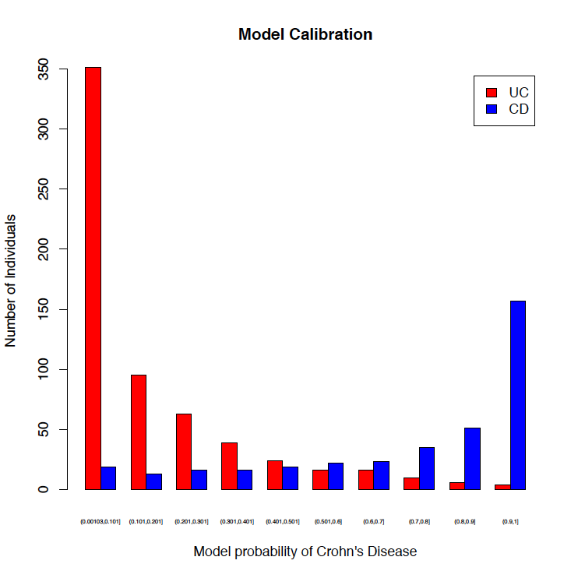
Molecular diagnostics in IBD
‘Molecular’ diagnosis (based on GWAS SNPs & serologic biomarkers) concordant with GI dx: CD & UC patients can be distinguished accurately
Model highlights potential misclassification – handful of patients have strong prediction in favor of the opposite disease
Jonah Essers (MGH/CHB), Dermot McGovern (CSMC)

Slide 32
Molecular diagnostics flag patients with worst outcome
UC |-- unc --| CD
Black dots represent patients diagnosed with UC who later underwent
colectomy and then developed full-blown Crohn’s disease

Slide 33
Can we implicate specific cellular contexts?

Slide 34
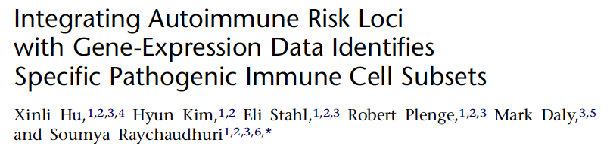
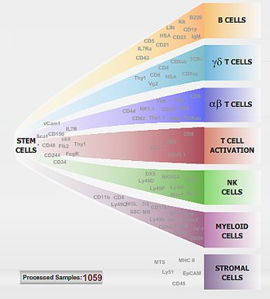
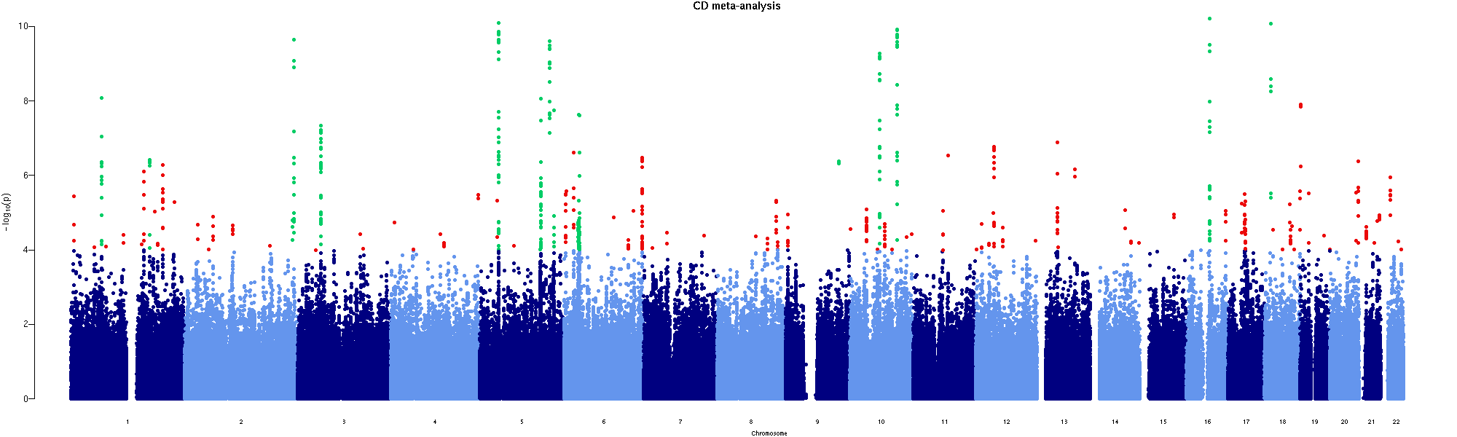
Are human GWAS hits harboring
loci significantly co-expressed in specific immune cell subsets?
ImmGen data set:
223 murine immune cell subsets
Expression measured on 15,149
human homologs

Slide 35
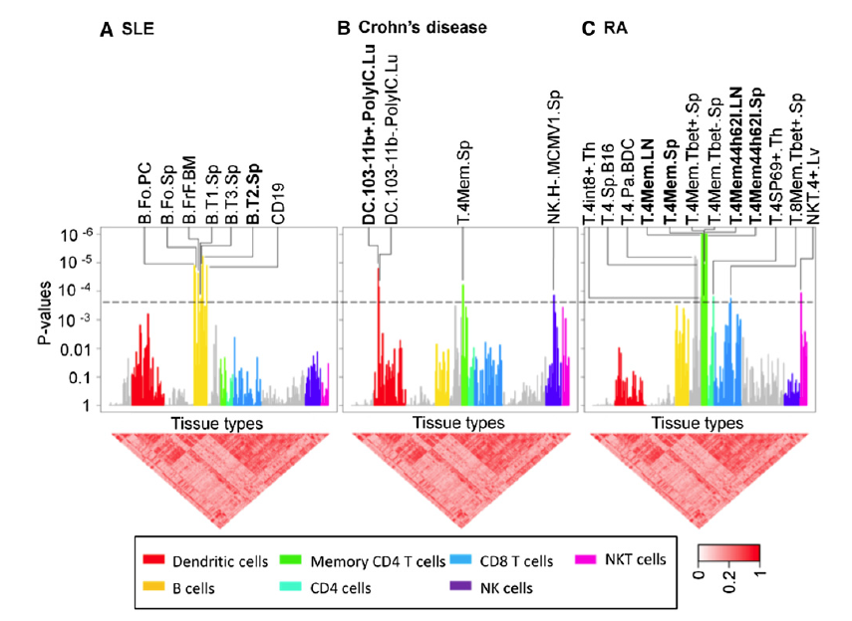
Surprisingly, yes

Slide 36
At scale, fine mapping becomes possible
IBD Immunochip:
30,000 cases with ultra high density genotype data for 120 of the confirmed associated regions

Slide 37

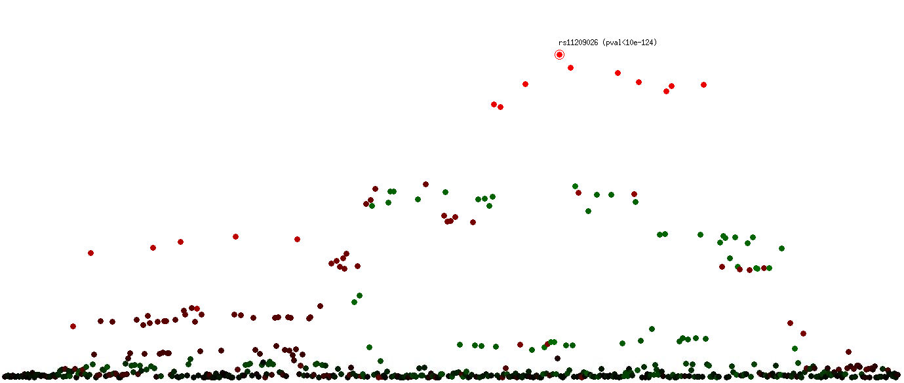
Example: IL23R region
10 SNPs spanning a 43KB region are in LD with rs11209026 (r² > 0.5).
1.0
0.0
-1.0
correlation coefficient r
p = 5 x 10e-8

Slide 38
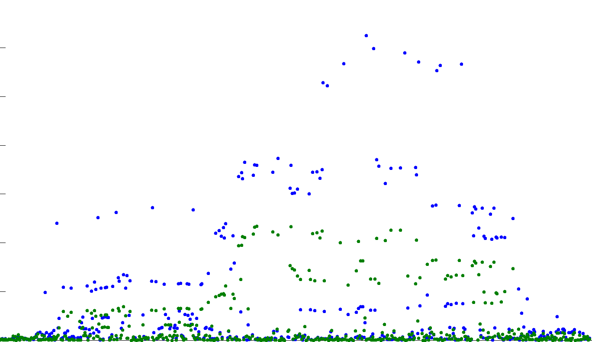
Residual signal after controlling for rs11209026
#1 rs11209026, OR 0.57, p<10⁻¹²⁴
#2 rs10889669, OR 1.21, p<10e⁻⁴⁶
. . .
. . .
. . .

Slide 39
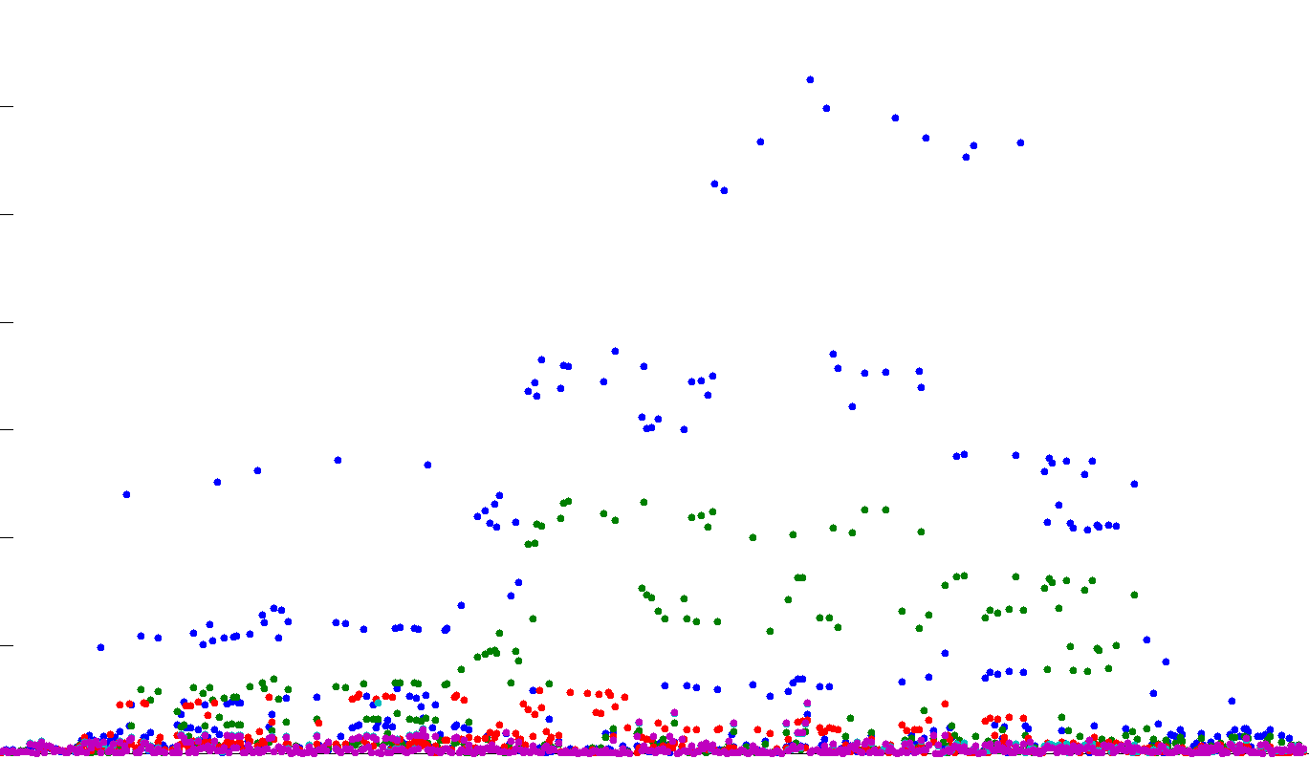
Residual signal after controlling for rs11209026
#1 rs11209026*, OR 0.57, p<10⁻¹²⁴
#2 rs10889669, OR 1.21, p<10e⁻⁴⁶
#3 rs1321150, OR 1.11, p<10e⁻¹¹
#4 rs76418789*, OR 0.58, p<10e⁻⁹
#5 rs41313262*, OR 0.73, p<10e⁻⁹
* missense coding mutation

Slide 40
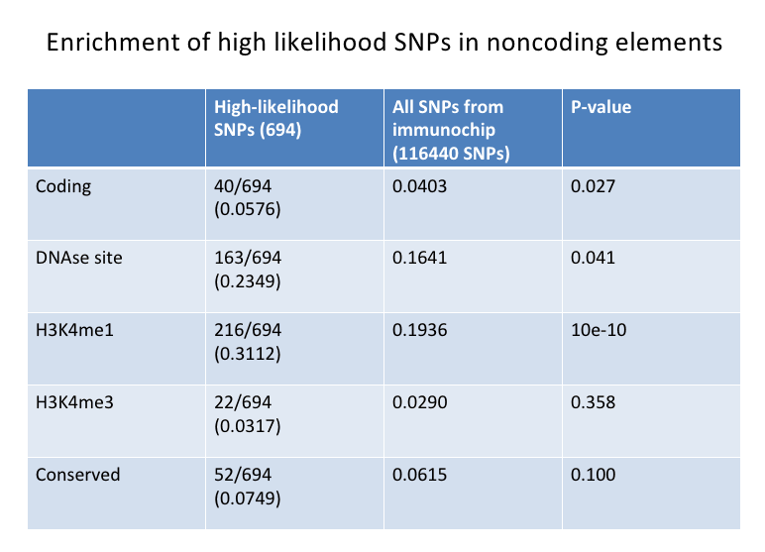
Functional annotation of coding GWAS hits
>75% of the GWAS association signals were noncoding (i.e., no coding SNP in credible set of associated variants after Immunochip & 1000 Genomes imputation). These SNPs showed enrichment for ENCODE functional elements.

Slide 41
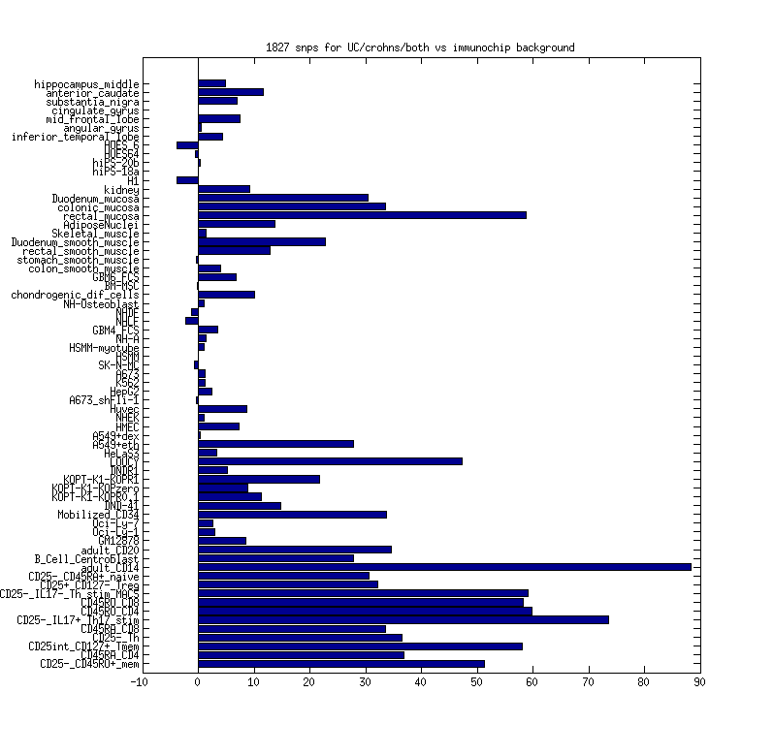
More detailed experimental data demonstrates this is specific to relevant cell types

Slide 42
Sounds great – but where are we in psychiatric disease?
Pause for questions…

Slide 43
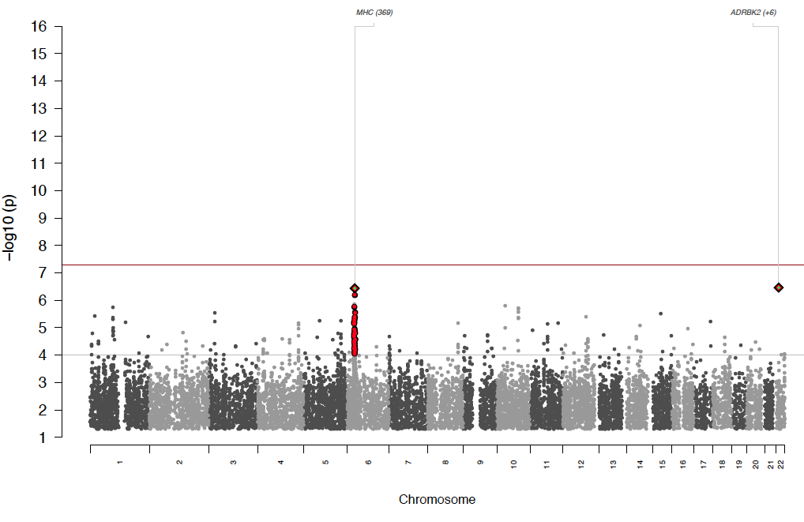
Like linkage, early GWAS efforts in SCZ did not conclusively define risk loci
International Schizophrenia Consortium 2009

Slide 44
GWAS has failed
Long live GWAS

Slide 45
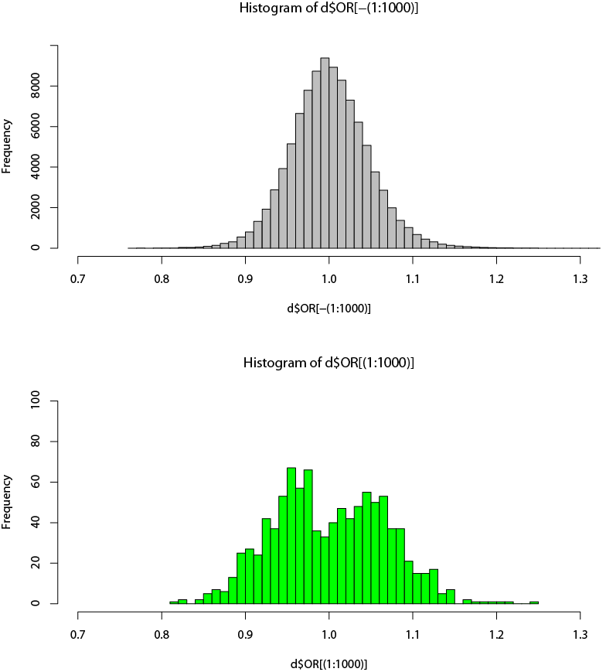
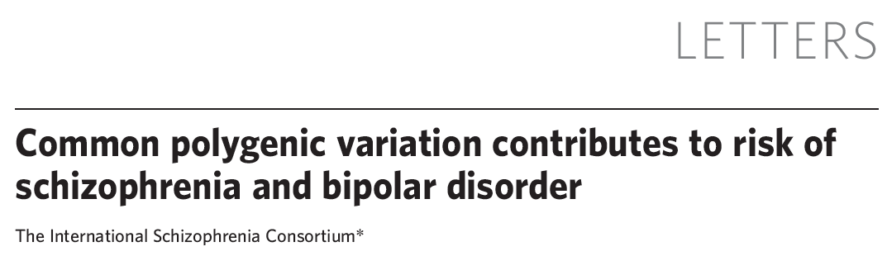
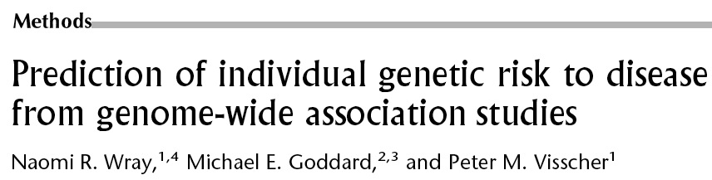
Of Purcell, Visscher and Polygenes
p < 10⁻⁵ to 10⁻²⁸
ISC
X
R²
Test
The International Schizophrenia Consortium (ISC)
All p > 0.05
[ISC 2009]
MGS
Euro.
O’Donovan
STEP-BD
WTCCC
CAD
CD
HT
RA
T1D
T2D
Schizophrenia
Bipolar disorder
Non-psychiatric (WTCCC)

Slide 46



Fundamental advance 3:
Collaboration
PGC Schizophrenia group
Michael O'Donovan
Pamela Sklar
Patrick Sullivan
Doug Levinson
Ed Scolnick
Pablo Gejman
Aiden Corvin
Anil Malhotra
Ayman Fanous
D Blackwood
Hugh Gurling
Kenneth Kendler
Michael Gill
Michael Owen
Ole Andreassen
Roel Ophoff
David St. Clair
Sven Cichon
Thomas Schulze
Peter Holmans
Thomas Lehner
Alan Sanders
Thomas Werge
Dan Rujescu
Bryan﻿﻿ Mowry﻿﻿
Mathew﻿﻿ Keller﻿﻿
PGC statistical analysis group
Stephan Ripke
Naomi Wray
Frank Dudbridge
Peter Holmans
Danyu Lin
Edwin van den Oord
Shaun Purcell
Ben Neale
Nick Craddock
Danielle Posthuma
Ken Kendler

Slide 47
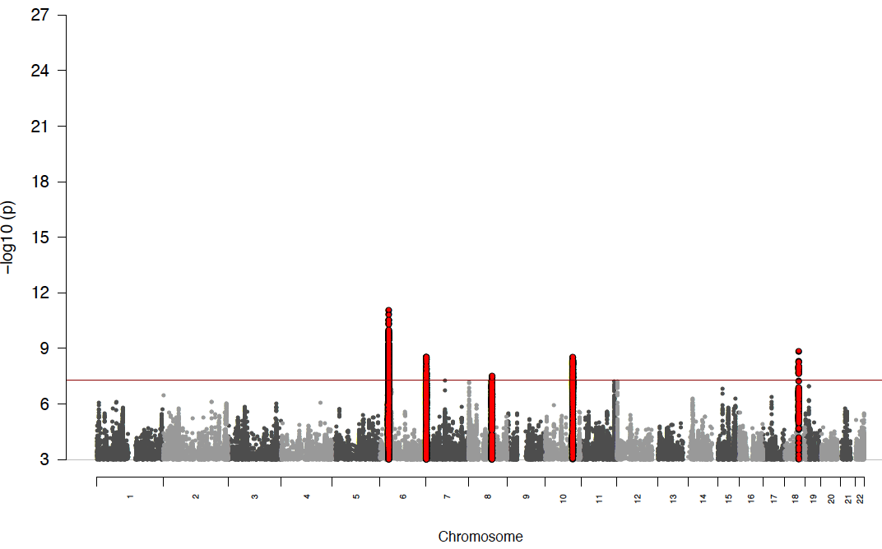
PGC-SCZ version 1
9394 cases, 12462 controls
PGC-SCZ, Nature Genetics, Sept 2011

Slide 48
2011: The path of schizophrenia compared to other “successful” GWAS traits
 | Adult height | Crohn’s | Schizophrenia
 | (per 5000/5000) | (per 1000/1000) | (per 3000/3000?)
1x | 0 | 2 | 1
2x | 2 | 4 | 2
3x | 7 | 5 | 6
9x | 68 | 51 | -
18x | 180 | - | -
Significantly associated regions (p < 5e⁻⁰⁸)
Similar trajectories in type 1 & 2 diabetes, serum lipid levels – the variable
appears to be the (unpredictable) sample number required to move onto this path
Notes:
Eric Lander!!

Slide 49
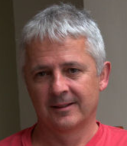
4998 Sweden 1-6
2012: Tripling last years sample!!!
8167 PGC1-
234 Estonia
377 TOP (Norway) wave2
577 Pfizer Pharma
6035 CLOZUK*
649 Bulgarian Trios
* Including COGGS
894 Ashkenazi
1223 JnJ Pharma
1293 Irish WTCCC2
1338 Bonn wave2
28,441 Controls

Slide 50
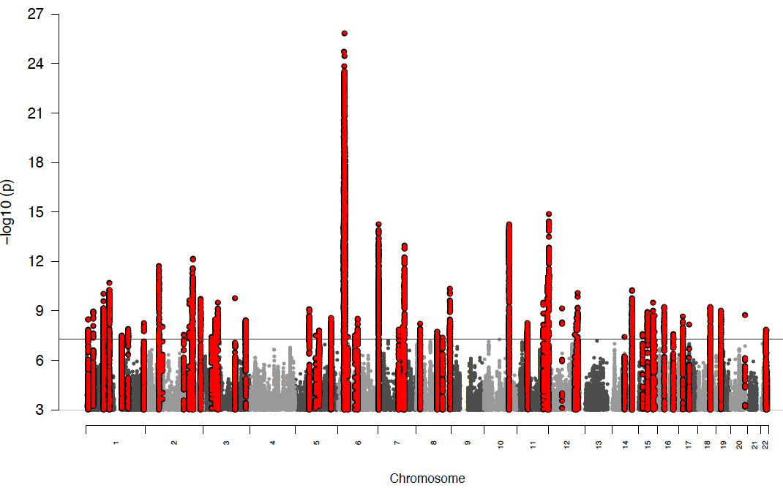
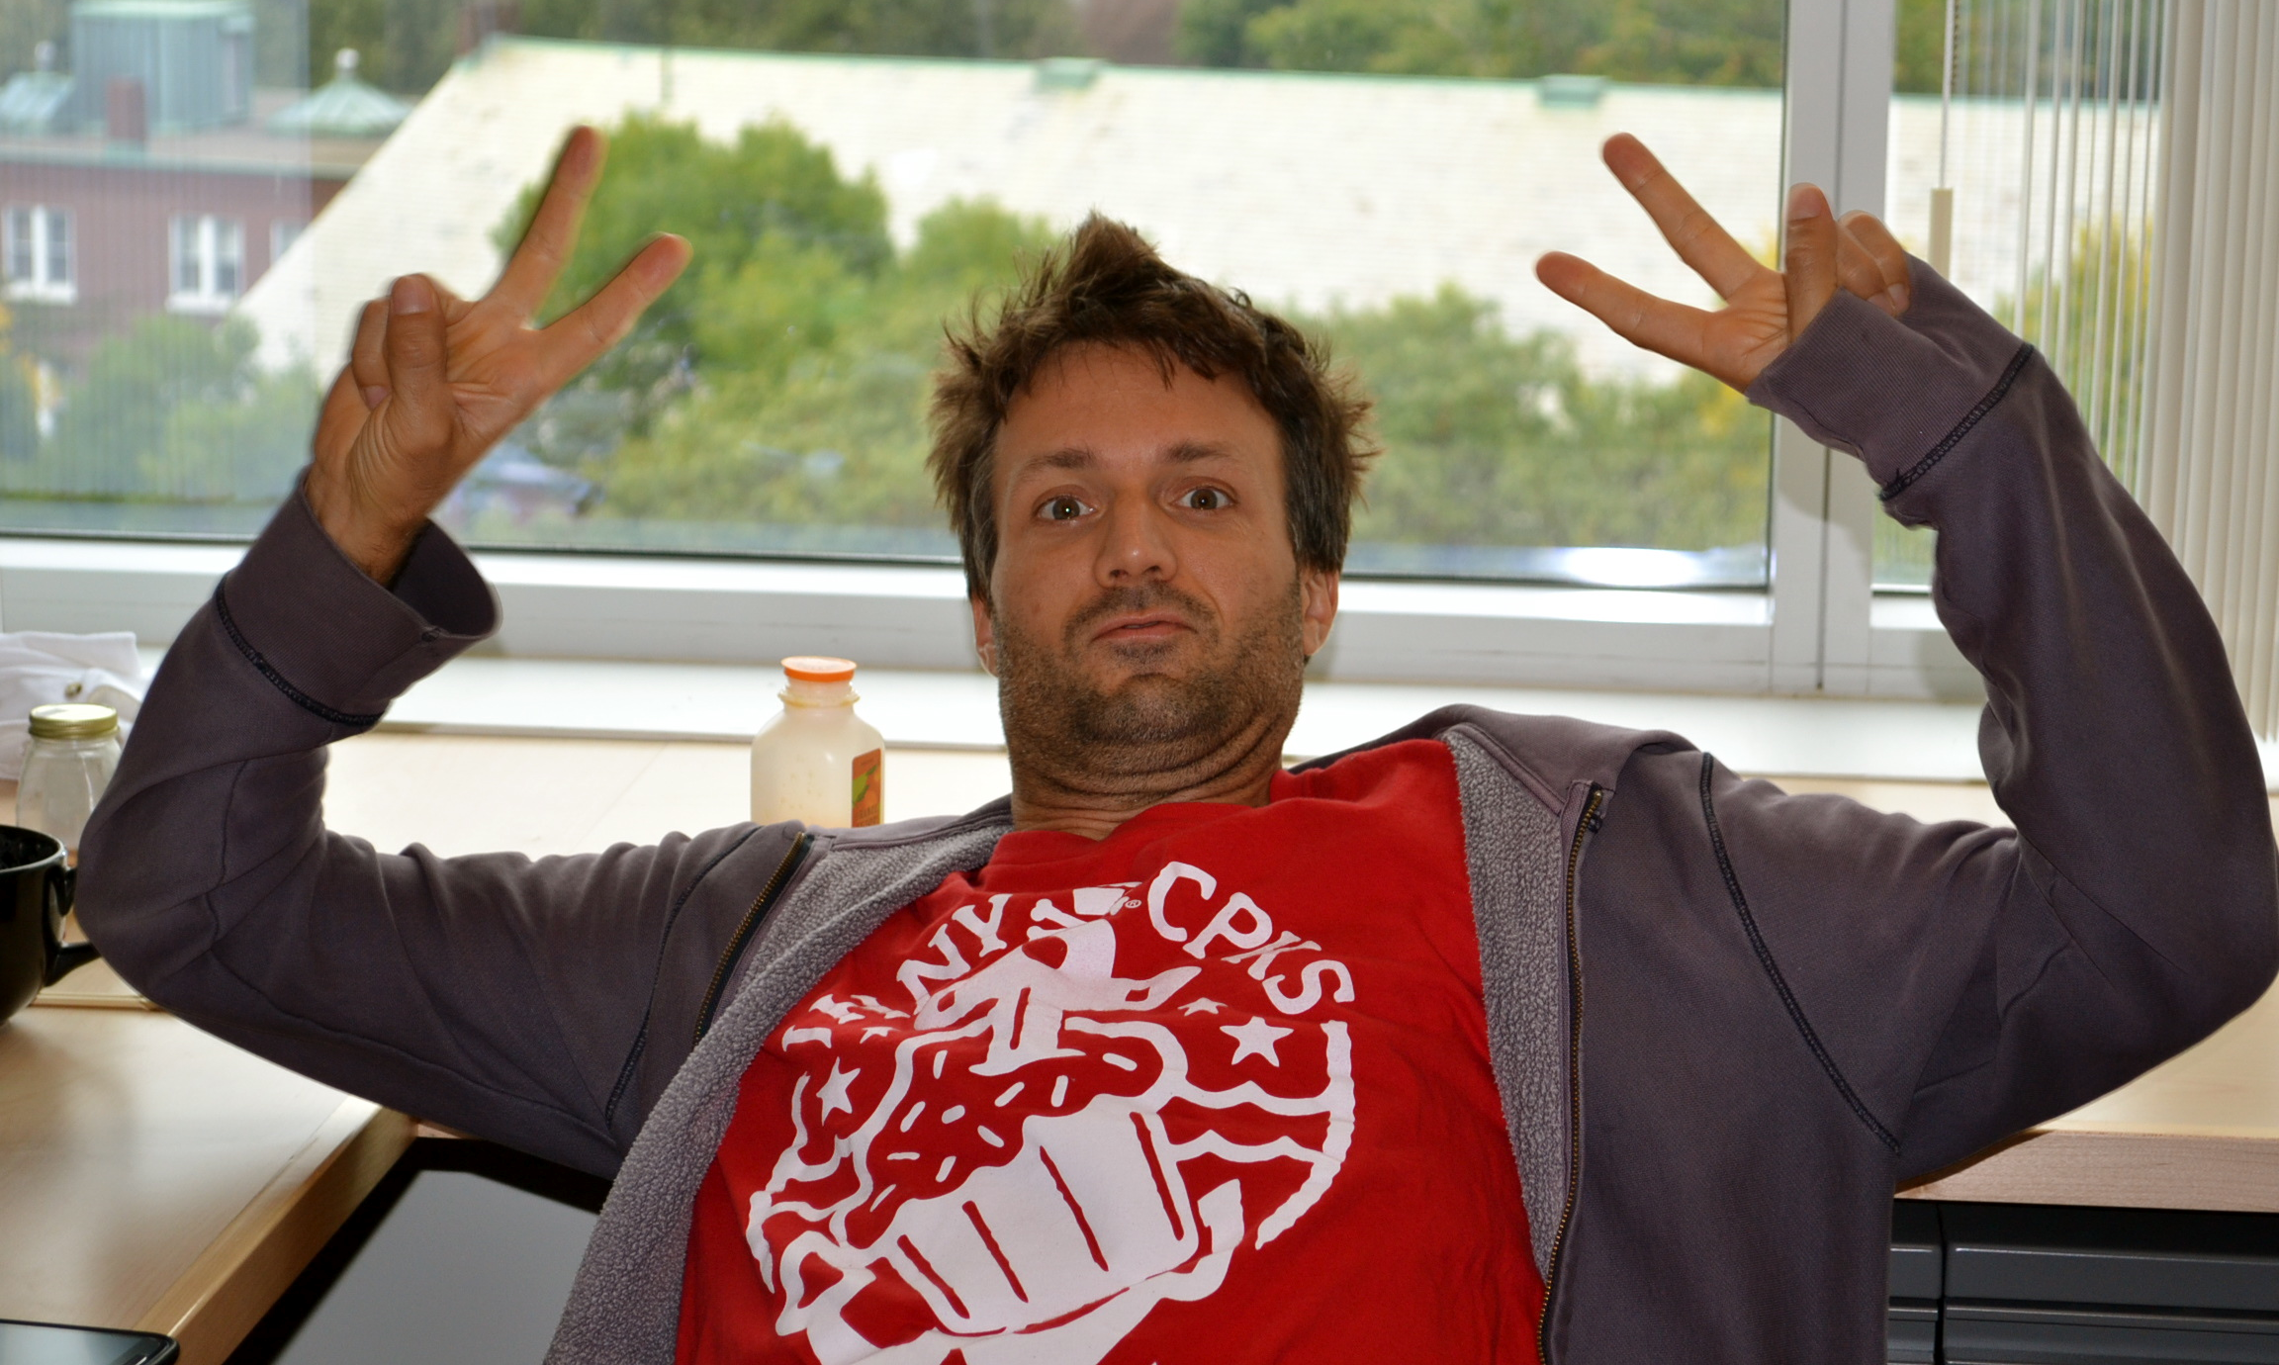
PGC-schizophrenia wave 2 combined analysis of 25785 cases and 28441 controls
62 distinct regions with SNPs exceeding p < 5x10⁻⁸
Unpublished and preliminary results presented at WCPG in Hamburg in October 2012
Stephan Ripke
Mick O’Donovan
Pat Sullivan and a
cast of, well, many!

Slide 51
2012: The path of schizophrenia compared to other (successful) traits
 | Adult height | Crohn’s | Schizophrenia
 | (per 5000/5000) | (per 1000/1000) | (per 3000/3000?)
1x | 0 | 2 | 1
2x | 2 | 4 | 2
3x | 7 | 5 | 6
9x | 68 | 51 | 62
18x | 180 | - | -
Significantly associated regions (p < 5e⁻⁰⁸)
Notes:
Eric Lander!!

Slide 52
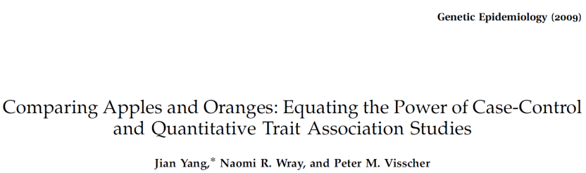
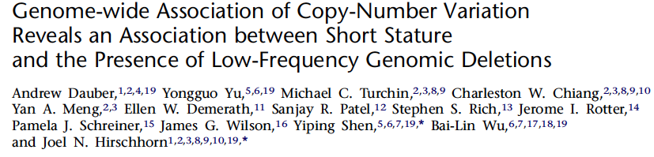
Height vs. Schizophrenia
Similar high heritability
Results of GWAS for schizophrenia eerily similar to applying defining a 1% tail of stature as affected
Consider also:
  200 Mendelian disorders have significant impact on stature
  22q11 deletion has a significant short stature - a 1 s.d. effect on height corresponds to ~10x increase in ‘shortness’ defined by 1% tail

Slide 53
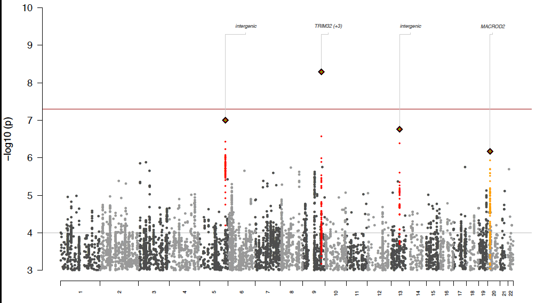
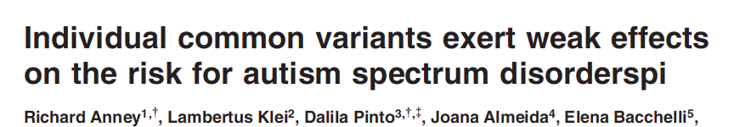
Will this work for childhood neuropsychiatric traits?
We will see…
 | Adult height | Crohn’s | Schizophrenia
 | (per 5000/5000) | (per 1000/1000) | (per 3000/3000?)
1x | 0 | 2 | 1
2x | 2 | 4 | 2
3x | 7 | 5 | 6
9x | 68 | 51 | 62
18x | 180 | - | -
Autism, ADHD
Notes:
Eric Lander!!

Slide 54
The other side of the coin
Next-generation sequencing
And
Neuropsychiatric disease

Slide 55



What’s in an exome?
~20,000 DNA variants in/near protein coding DNA
~200 rare missense variants
~100 loss-of-function variants (~20 rare or private)
A few things are a bit more interpretable…but not absolute slam dunks…
~1 de novo variant per exome (only ~5% LoF)
<5% chance that an individual has a complete knockout of a single well-preserved* gene anywhere in the genome
* well-preserved = 98-99% of genes without a common LoF mutation

Slide 56
Fundamental Challenges
Extreme polygenicity
  If rare variants in a particular gene confer risk, it is likely only a small fraction of cases carry them
Extremely high background rate of neutral variation
  >300,000 variants found ‘on target’ to date
  Additional complexity vs. GWAS since neutral variants will exist even in ‘causal’ genes

Slide 57
ARRA Autism Sequencing Collaboration
Collaboration among expert sequencing centers with experienced autism genetics labs
Co-funded by NIMH and NHGRI
  Particular thanks to Thomas Lehner, Adam Felsenfeld and Pat Bender
Investigators:
  Joe Buxbaum (MSSM), Mark Daly (Broad/MGH), Bernie Devlin, Kathryn Roeder (Pittsburgh/CMU), Richard Gibbs, Eric Boerwinkle (Baylor), Jerry Schellenberg (Penn), Jim Sutcliffe (Vanderbilt)

Slide 58
Data collected to date
Phase 1: 920 cases and 892 controls
  Match autism cases to NIMH Controls on PCA distance using common variation
  Sequencing split between Broad and Baylor
  Pair samples through NGS process
  Production recently completed, analysis ongoing
Phase 2: 300+ trios
  Sequencing performed at all consortium sites
  Many more in process
Data deposited to dbGAP rapidly and available to the community

Slide 59
Nonsense mutations specific to cases or controls
Many nonsense mutations seen in ~1% of cases
and no controls – however nearly just as many
seen uniquely in controls
Likely some are relevant – but which ones?!?!

Slide 60
Distribution of gene-wise statistics full case-control data set
Consistent with a variety of gene-wise tests
(CAST, CMC, VT, Cα, SKAT) and many differently weighted single marker tests
Li Liu
Ben Neale
Kathryn Roeder

Slide 61
Similar story in many complex diseases
As in the early waves of GWAS, large exome-based studies of schizophrenia, diabetes, MI, etc. (N ~ 2500 cases) are not deviating from the null distribution

Slide 62


Power is very limited…
Even for best case scenarios
(genes with known strong effect of rare variants on phenotype) – numbers of samples currently examined in exome studies don’t remotely achieve genome-wide significance

Slide 63
What to do?
Focus on genes with prior genetic evidence
Focus on rare, interpretable categories of variation
Dramatically increase sample size

Slide 64


Rare, strong acting alleles can be found alongside weaker, common alleles from GWAS
Splice variant in CARD9 (MAF ~ 0.5%) causes premature truncation of protein
and strongly protects against the development of Crohn’s disease (p < 10⁻¹⁶)

Slide 65
CD: insights about CARD9 suggest therapeutic hypothesis
Crohn’s gene
Cell model
Therapeutic hypothesis
Risk variant
Protective variant
CARD9
risk
Drug leads that mimic the protective variant may reduce inflammation
CARD9
protective
Inflammation
Inflammation
CD

Slide 66


 | R1210C Hets |  | No R1210C |  | exact p | exact p (condition Y402H)
 | Case | Control | Case | Control
Boston-GWAS | 13 | 0 | 694 | 303 | 0.0094 | 0.0030
Boston-Replication | 10 | 1 | 1195 | 656 | 0.058 | 0.0086
Baltimore Replication | 10 | 0 | 492 | 160 | 0.062 | 0.016
Siblings | 7 | 0 | 2 | 2 | 0.033
Meta-analysis |  |  |  |  | 7.0E-06 | 1.3E-07
p=2 x 10⁻⁶
rare R1210C variant of CFH
confers strong risk (OR ~ 10-20)
to disease and significantly earlier onset within cases

Slide 67
For purposes of presentation, loci are named according to a nearby gene of interest. In only a few cases is the causal gene yet proven.
Lipids: GWAS
ABCA1, ABCG5/G8,
APOA1, APOA5, APOC2,
APOE, LCAT, LDLR,
LDLRAP1, LIPC
Loci identified by GWAS
MTTP, LMF1,
SAR1B
Loci causing Mendelian dyslipidemic syndromes
SORT1, CSPG3, MAFB, HNF1A,
TIMD4, GALNT2, MMAB, FADS,
ANGPTL4, C9orf52, HNF4A, GCKR, MLXIPL, TRIB1, AMAC1L2, PLTP, PP1R3B, MYLIP, CILP2, DNAH11, KIAA1305, HLA, BRCA2, LIN3, HPR, GFI3, GPAM, ST3GAL4, ABO, YSK4,
GRINA, ANXA3, TIMD4,FN1,
MOSC1, CR59641,UBE2L3, PGS1
PPP1R3B, TTC39B, PDE3A, MACF1
C6orf106, RBMS, OR4C46, ARLIS, RPS3A, LILRA, LACTB, JMJDIC,
CMIP, DR1, SLC39A8, MVK,
TRPS1, KLF14, COBLL1
etc, etc
ANGPTL3
HMGCR, NPC1L1
PCSK9, APOB, CETP LPL
Loci targeted by lipid lowering therapies
Rader and Hobbs, Harrison’s 17th ed.
PPARA
Willer, et al Nat Genet 2008
Kathiresan, et al Nat Genet 2008
Kathiresan*, Willer* et al , Nat Genet 2009
Slide courtesy of S. Kathiresan
Teslovich, Musunuru, Nature 2010

Slide 68
PGC-schizophrenia wave 2 combined analysis of 25785 cases and 28441 controls
62 distinct regions with SNPs exceeding p < 5x10⁻⁸
Unpublished and preliminary results presented at WCPG in Hamburg in October 2012
Stephan Ripke
Mick O’Donovan
Pat Sullivan and a
cast of, well, many!

Slide 69
Schizophrenia GWAS provides insight into lack of exome findings…
Disproportionately fewer positive results in PGC-SCZ v2 at lower frequencies…
Not simply a function of information content or statistical artifact at low frequencies
Likely power is greatly limited at low frequencies–
Roughly speaking a common variant with an OR = 1.2 is comparable on a power and variance –explained level to a 0.5% variant with an OR = 3
There is no reason based on current understanding of the complex architecture and selective pressure to presume what the specific relationship between lower frequency and increasing OR is…

Slide 70
What about the interpretable part of the exome?
De novo variation and complete knockouts…

Slide 71
Evaluating de novo mutations requires careful calculation of expectation
Many factors need to be considered
  Gene size
  Base composition XY₁Z -> XY₂Z
    192 possibilities, but millions of intergenic SNPs to fit
  Sequence coverage …and more!
Antonarakis, 2006
Frequency
Frequency
-log10(Probability of a Missense Mutation)
-log10(Probability of a Missense Mutation)

Slide 72
Evaluating de novo mutations requires careful calculation of expectation
Many factors need to be considered
  Gene size
  Base composition XY₁Z -> XY₂Z
    192 possibilities, but millions of intergenic SNPs to fit
  Sequence coverage …and more!
Model predicted rates of silent mutations per gene are highly correlated (r = 0.89) with the observed number of singleton silent variants in the NHLBI ESP database
Antonarakis, 2006
Frequency
Frequency
-log10(Probability of a Missense Mutation)
-log10(Probability of a Missense Mutation)

Slide 73
Observations from our initial study
Neale et al, Nature, April 4 2012
160 SNV mutations across 173 trios in coding exons or conserved splice sites = 0.925/trio (expected 0.865) (modest excess, n.s.)
Per trio event distribution is exquisitely Poisson
30% silent (expected 30%)
Small excess of nonsense variants (10 vs. 5.5 expected, p=0.04) encouraging…
Statistically speaking, little evidence for major contribution from de novo events –
At most 10-20% of observed events can be relevant to autism risk and the clear
majority of patients do not carry a relevant de novo mutation

Slide 74

Comparing de novo variation to random and standing variation
OBS EXP STANDING VARIATION
De novo mutations in autism mirror random mutation quite closely,
but are markedly different from standing variation in the exome

Slide 75
Here again, collaboration is key to progress
Now just over 1000 trios across 4 published studies and newer data
Comparisons to well-calibrated mutation model and to observed rates in unaffecteds
Vast majority of de novo missense variants and half the de novo LoF are likely unrelated to autism risk

Slide 76
Most compelling results becoming convincing…
N=1061 trios and counting
Test 1: excess of de novo LoF
Test 2:
Excess of de novo
LoF+missense
22 less significant genes with >= 2 LoF+missense events not shown
Appropriate threshold for genome-wide significance roughly 1x10⁻⁶
.05 / (N_{genes} * N_{tests})
N_{tests} here set at 2 (all LoF, all LoF+missense)
Kaitlin Samocha

Slide 77
Similar story from rare inherited knockouts
Clear excess of ‘human knockouts’ in autism cases versus controls – considering only genes where frequency of loss-of-function < 5%
  Autosomal rates of rare 2-hit KOs
    6.7% in cases vs. 3.3% in controls (p<.002)
  Hemizygous male KO rate on X
    5.2% in male cases vs. 2.7% in male controls (p<.01)
Elaine Lim
Neuron, in press

Slide 78
What have we learned from autism sequencing to date
Excess of de novo mutations (perhaps 10-20% of cases have a relevant exome-based de novo mutation)
These generally do not appear to be Mendelian causes – but risk factors like CNVs that confer 5-20x relative risk
Evidence of a recessive LOF origin in perhaps another 5% of cases
Majority of cases do not have any ‘simple’ genetic risk factor (de novo CNV, de novo pt mutation, recessive LOF hit)

Slide 79
Exome/genome sequencing is by no means a panacea – and in fact in some instances early returns are reinforcing our commitment to GWAS…
….but as with the fits and starts in the early days of GWAS, there are signs of positive things to come

Slide 80
Credits
Autism Exome Team
  Ben Neale
  Aniko Sabo
  Christine Stevens
  Elaine Lim
  Kaitlin Samocha
  Li Liu
  Paz Polak, Shamil Sunyaev
  Jared Maguire
  Liz Rozzin
  Many others involved in sequencing and analysis at all sites!!
ARRA Investigators
  Joe Buxbaum
  Bernie Devlin
  Richard Gibbs
  Jerry Schellenberg
  Jim Sutcliffe
  Kathryn Roeder
  Eric Boerwinkle
PGC analysis team
Stephan Ripke
Naomi Wray
Frank Dudbridge
Peter Holmans
Danyu Lin
Edwin van den Oord
Shaun Purcell
Ben Neale
Nick Craddock
Danielle Posthuma
Ken Kendler
Sarah Medland
Peter Visscher
Gerome Breen
Lizzy Rossin
Colm O’Dushlaine
Phil Lee
Biggest thanks to all the researchers and clinicians who have contributed to the PGC effort!!!
Supported by NIMH – Thomas Lehner
Please write with questions/comments – mjdaly@atgu.mgh.harvard.edu

Slide 81
Crohn’s Disease
Ramnik Xavier & Lab
Alan Huett, Petric Kuballa, Agnes Gardet, Aylwin Ng, Yair Benita
John Rioux & Lab (UdeM)
Philippe Goyette, Guillaume Lettre
Investigators of NIDDK IBDGC
Judy Cho
Steve Brant
Rick Duerr
Jerry Rotter
Mark Silverberg
Dermot McGovern
Miles Parkes & Wellcome Trust IBD
Belgian-French IBD Consortium
IIBDGC Analysis Team
Jeff Barrett, Dan Nicolae, Luke Jostins, Michel Georges, Sarah Hansoul, Carl Anderson
Broad Institute
Christine Stevens
Noel Burtt
Stacey Gabriel
David Altshuler
Mark dePristo
Kiran Garimella
Eric Banks
& the GSA team!
ATGU
Shaun Purcell
Ben Neale
Daniel MacArthur
Chris Cotsapas
Jonah Essers
Jason Flannick
Todd Green
Andrew Kirby
Elaine Lim
Jared Maguire
Ben Neale
Soumya
Raychaudhuri
Stephan Ripke
Manny Rivas
Liz Rossin
Kaitlin Samocha
Ayellet Segre
Ben Voight

Slide 82
PGC Worldwide Lab Call Upcoming Event
DATE: Friday, February 8th, 2013
PRESENTERS: Eli Stahl and Naomi Wray
TITLE: “TBA”
START: We will begin promptly on the hour. [Note will start 1 hr later than past 2 calls]
1100 EST - US East Coast
0800 PST - US West Coast
1600 GMT - UK
1700 CET - Central Europe
0300 EDT – Australia (Sat, January 12th, 2013)
DURATION: 1 hour
TELEPHONE: TBD
PASSCODE: TBD

